Slide 1
Data Platforms and Artificial Intelligence
Challenges and Applications
Matteo Francia – University of Bologna

Slide 2
whoami
Matteo Francia, Ph.D.
Email: m.francia@unibo.it
Adjunct Professor @ DISI --- UniBO
Teacher of “Big Data and Cloud Platforms”
Research topics
Big data / database
Precision agriculture and spatio-temporal analytics
BIG (Business Intelligence Group)
https://big.csr.unibo.it/

Slide 3
Program
Lecture 1: Introduction to Big Data
Lecture 2: Polyglot Persistence
Lecture 3: The Metadata Challenge

Slide 4
Exam
Write and send me a short essay
About 5-10 pages long
Discuss relationships between your research interests and the topics presented in the course
Explain how big data challenges may have an impact on your work

Slide 5
Introduction to Big Data
Matteo Francia – University of Bologna

Slide 6
How did we get here?
Data-Driven Innovation
Use of data and analytics to foster new products, processes and markets
Drive discovery and execution of innovation, achieving new services with a business value
Analytics
A catch-all term for different business intelligence (BI)- and application-related initiatives
E.g., of analyzing information from a particular domain
E.g., applying BI capabilities to a specific content area (e.g., sales, service, supply chain)
Advanced Analytics
(Semi-)Autonomous examination of data to discover deeper insights, make predictions, or generate recommendations (e.g., through data/text mining and machine learning)
Augmented Analytics
Use of technologies such as machine learning and AI to assist with data preparation, insight generation and insight explanation to augment how people explore and analyze data
https://www.gartner.com/en/information-technology/glossary (accessed 2022-08-01)

Slide 7
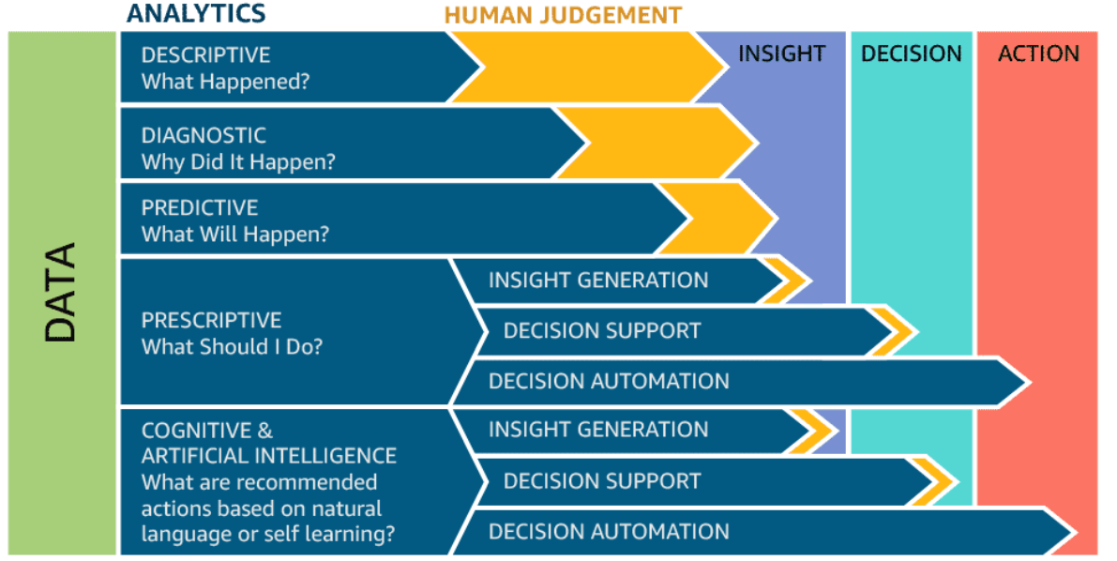
How did we get here?

Slide 8
What we are going to do
Define big data
Why the hype behind big data
Architectures
Hardware
Software
Data storage
Data processing (batch, interactive, streaming)
Reference architectures

Slide 9
Define big data
The term big data comes in two flavors
Noun: “We have big data"
Adjective: “We use big data tools"

Slide 10
Big data as a noun
When does data become big?
BIG
DATA
IOPS
(Input/Output Operations Per Second)
Normal
processing
capability
Data volume

Slide 11
Big data as a noun
Common definitions
"Big data exceeds the reach of commonly used hardware environments and software tools to capture, manage, and process it with in a tolerable elapsed time for its user population." Teradata Magazine article, 2011
"Big data refers to data sets whose size is beyond the ability of typical database software tools to capture, store, manage and analyze." The McKinsey Global Institute, 2012
"Big data is data sets that are so voluminous and complex that traditional data processing application softwares are inadequate to deal with them." Wikipedia
Notes:
Oggi: per Big Data intendiamo quelle architetture e quegli strumenti che permettono di gestire ed elaborare i dati in un ambiente distribuito.
Il fatto che tu «non sia in grado di gestirli» non significa che siano big data

Slide 12
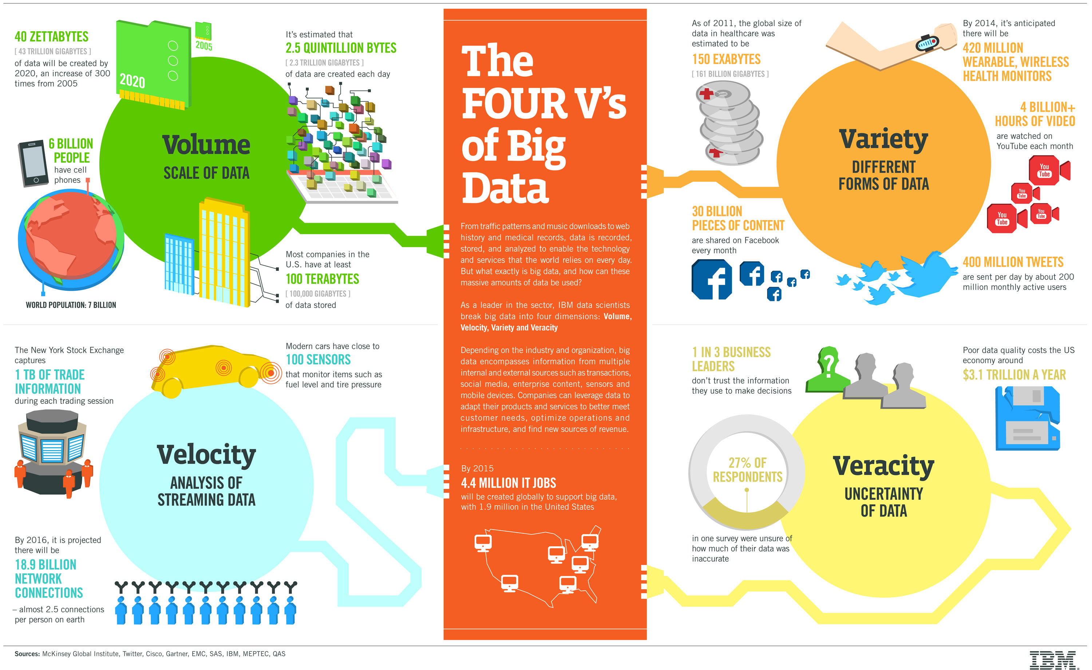
Big data as a noun – The V’s
http://www.ibmbigdatahub.com/sites/default/files/infographic_file/4-Vs-of-big-data.jpg

Slide 13
Big data as a noun – The V’s
Volume
Large quantity of data
Velocity
Refers to the speed of data production…
…and to the speed of consumption and analysis
Variety
Structured, unstructured, multimedia
Veracity
Refers to the trustworthiness of data
Potentially inconsistent, incomplete, ambiguous, obsolete, false, approximate
Notes:
Veracità: GPS inaccurato, sentiment dubbio, disinformazione..
uncertainty
wrong sensor data (malfunctioning, gps..)
social data (wrong parsing, bad phrasing)
obsolete data

Slide 14
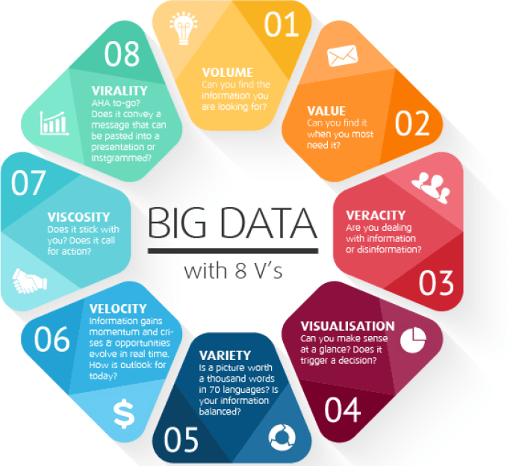
Big data as a noun – The V’s
How many V’s?

Slide 15
Big data as an adjective
When used as a noun, the boundary between normal and big data is vague
When used as an adjective, its meaning is more specific
Big data architecture (e.g., the Lambda architecture)
Big data tools (e.g., Apache Spark)
Big data paradigm (e.g., Map-Reduce)

Slide 16
Why the hype
We have always known that data is powerful
What has changed?
Notes:
Perchè valore nei big data? Cos'è cambiato rispetto al passato? Alla fine, sempre di dati si tratta.
Nel momento in cui sono in grado gestire questa grande mole di dati, cambia fortemente il mio approccio all'analisi. Perchè
sono in grado di gestire dati che prima ero obbligato a scartare
sono in grado di applicare degli algoritmi che in presenza di pochi dati non avrebbero funzionato
Data grows faster than energy on chip: più dati di quell che possiamo elaborare
Anthony Goldbloom: CEO importante startup americana

Slide 17
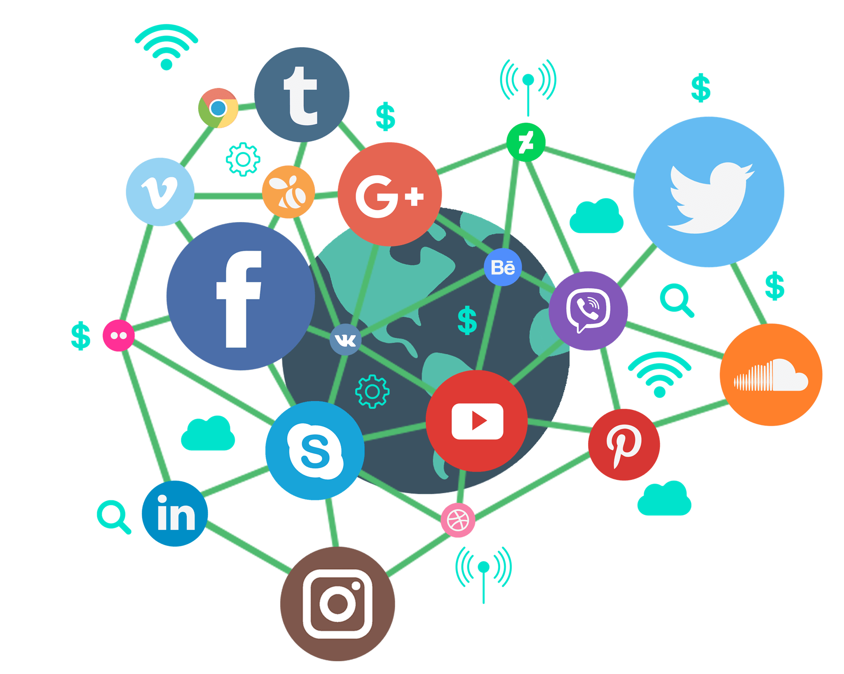
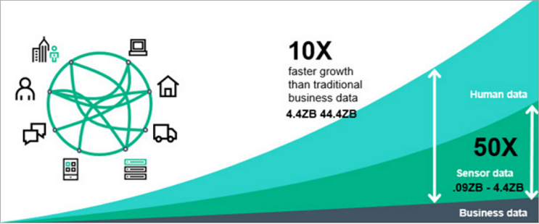

Data growth
New sources that drive an exponential growth of data
Opens to new analytical opportunities
Notes:
Cars generate 25GB/hour = 300TB/year

Slide 18
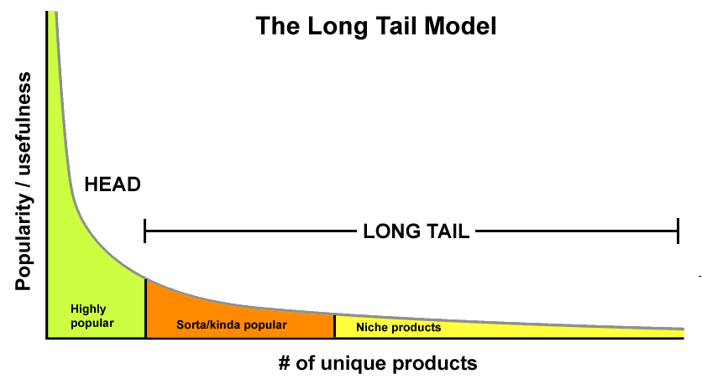
The long tail
The highest value does not come from the small set of highly popular items, but from the long list of niche items
Put together, the insignificant data is actually the most valuable
The inverse of the 80-20 Pareto rule
"We sold more items today that didn't sell at all yesterday than we sold today of all the items that did sell yesterday" - Amazon employee
Notes:
Il modello long tail si contrappone a Pareto. Pareto dice: 20% delle cause produce 80% degli effetti. Tante applicazioni, tra cui: il 20% dei miei dati sono quelli che racchiudono l’80% del valore.
Long tail dice sì, è vero che il 20% sono più “importanti”, ma è dall’analisi della lunga coda che traggo il maggior valore.
Applicazione sul modell di business di amazon
Applicazione sui dati: prima era anche una necessità concentrarsi solo sul 20% per questione di risorse; oggi devo essere in grado di collezionare quanti più dati possibili, perchè anche se apparentemente poco significativi, è dalla massa che riesco a trarre il maggior valore.
Il principio di Pareto indica che, per massimizzare i profitti, ha senso focalizzarsi su pochi elementi principali, pochi elementi mainstream piuttosto che un'ampia diversificazione.
Il modello Long tail ci dice il contrario, ossia che è in quella marea di elementi di nicchia che mi devo concentrare, perchè sono talmente tanti da essere quelli complessivamente più importanti e più a valore; più diversifico, più sono in grado di accontentare tutti.
https://it.wikipedia.org/wiki/Coda_lunga

Slide 19
Bigger = Smarter (?)
Google Translate
You collect snippets of translations
You match sentences to snippets
You continuously debug your system
Why does it work?
There are tons of snippets on the Web
The accuracy improves as the training set grows
Notes:
(possibilità di addestrare modelli di apprendimento basandomi solo sull'esempio piuttosto che sulla progettazione del modello stesso)

Slide 20
Architectures
Hardware-wise
Software-wise
Data storage (files, databases)
Data processing (batch, interactive, streaming)
Reference architecture (components, lambda vs kappa)

Slide 21
Scaling
HW architecture
First of all, big data is big
It doesn't fit a single drive
It doesn't fit a single (typical) machine
Symmetric Multi Processing (SMP): several processors share the same RAM, the same I/O bus and the same disk(s)
Limited number of mountable physical devices
BUS bottleneck
Second, processing big data requires a lot of computing resources
Simply scaling only the disk is not an option
What do we do?
Scale up
Scale out
CPU
CPU
CPU
CPU
CACHE
CACHE
CACHE
CACHE
BUS
DISK
SHARED RAM

Slide 22
Scale up
HW architecture
Generally refers to adding more processors and RAM, buying a more expensive and robust server
Pros
Less power consumption than running multiple servers
Cooling costs are less than scaling horizontally
Generally less challenging to implement
Less licensing costs
Less networking equipment
Cons
PRICE
Greater risk of hardware failure causing bigger outages
Generally severe vendor lock-in
Not long-term: limited upgradeability in the future

Slide 23
MPP
HW architecture
In a Massively Parallel Processing (MPP) architecture there are several processors, equipped with their own RAM and disks, collaborating to solve a single problem by splitting it in several independent tasks
It is also called shared-nothing architecture
Mainly used for Data Warehouse applications (e.g., Teradata, Nettezza, Vertica)
Message Passing Interface (MPI)
CPUs
CPUs
CPUs
CPUs
RAM
RAM
RAM
RAM
DISK
DISK
DISK
DISK

Slide 24
Scale out
HW architecture
Generally refers to adding more servers with less processors and RAM
Pros
Much cheaper than scaling vertically
New technologies simplify fault-tolerance and systems monitoring
Easy to upgrade
Usually cheaper
Can literally scale infinitely
Cons
More licensing fees
Bigger footprint in the Data Center
Higher utility cost (electricity and cooling)
More networking equipment (switches/routers)
Notes:
Footprint = spazio occupato

Slide 25
Cluster
HW architecture
A computer cluster is a group of linked computers (nodes), working together closely so that in many respects they form a single computer
Typically connected to each other through fast LAN (slower than MPI)
Still shared-nothing, but every node is a system on its own, capable of independent operations
Unlimited scalability, no vendor lock-in
Number of nodes in the cluster >> Number of CPUs in a node
LAN
CPUs
CPUs
CPUs
CPUs
RAM
RAM
RAM
RAM
DISK
DISK
DISK
DISK

Slide 26
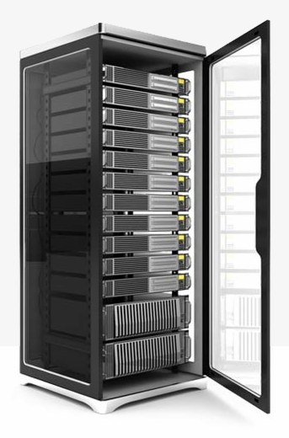
Cluster
HW architecture
Compute nodes are stored on racks
8–64 compute nodes on a rack
There can be many racks of compute nodes
The nodes on a single rack are connected by a network (typically gigabit Ethernet)
Racks are connected by another level of network (or a switch)
Intra-rack bandwidth >> inter-rack bandwidth
Notes:
«Compute nodes can fail» si può anche togliere

Slide 27
Commodity hardware
HW architecture
You are not tied to expensive, proprietary offerings from a single vendor
You can choose standardized, commonly available hardware from a large range of vendors to build your cluster
Commodity ≠ Low-end!
Cheap components with high failure rate can be a false economy
Notes:
https://it.wikipedia.org/wiki/Commodity
Commodity è un termine inglese che indica un bene per cui c'è domanda ma che è offerto senza differenze qualitative sul mercato ed è fungibile, cioè il prodotto è lo stesso indipendentemente da chi lo produce, come per esempio il petrolio o i metalli.
La commoditization accade quando beni o servizi di un determinato mercato perdono la loro differenziazione. Spesso questo avviene quando c'è una diffusione della conoscenza per offrire efficientemente quel determinato prodotto o servizio. Alcuni esempi di commoditization possono essere medicine non più protette da brevetto o microprocessori la cui tecnologia è diventata pubblica e la cui produzione esclusiva non è più garantita da contratti.

Slide 28
Commodity hardware
HW architecture
Example of commodity hardware specifications:
Processor: 12-core i7-8700 CPU @ 3.20GHz
Memory: 64 GB RAM
Storage: 3 × 4TB SATA disks
Network: Gigabit Ethernet
Yahoo!’s Hadoop installation:
> 100,000 CPUs in > 60,000 computers (as of 2017)
Used to support research for Ad Systems and Web Search
Also used to do scaling tests to support development of Hadoop
Notes:
http://bigdatausecases.info/entry/handling-kernel-upgrades-at-scale-the-dirty-cow-story

Slide 29
Multiple clusters
HW architecture
Having a single large cluster that is tantalizing to many organizations
No data silos, simpler governance
Multiple clusters are inevitable within medium-large enterprise settings
Resiliency
Every cluster sits within a single point of failure due to geography
Software development
Mitigate the risk of impacting critical production environments by isolating configuration, integration, or evolution testing and deployment
Workload isolation
Hardware resources tuned for specific workloads, less resource contention
Legal separation
Independent Storage and Compute

Slide 30
Multiple clusters
HW architecture
With the success of cloud services, the “independent storage and compute” solution for big data clusters is on the rise
Network is no more a problem
Data locality is (?)
Scalability is modularized
Disk and computation needs are different
Cost-efficient
Data must be persistent, 24/7
Compute nodes are activated only on demand

Slide 31
Data storage
Distributed file system
Distributed databases

Slide 32
Distributed FS
Data storage
Different implementations, relying on similar principles
Apache Hadoop
GCP Colossus
AWS EFS
Azure Data Lake

Slide 33
HDFS
Data storage
HDFS is a filesystem designed for storing very large files with streaming data access patterns, running on clusters of commodity hardware
A typical file in HDFS is gigabytes to terabytes in size. There are Hadoop clusters running today that store petabytes of data
Applications that run on HDFS need streaming access to their data sets. HDFS is designed more for batch processing rather than interactive use. The emphasis is on high throughput of data access rather than low latency of data access
HDFS applications need a write-once-read-many access model for files. A file once created, written, and closed need not be changed. This assumption simplifies data coherency issues and enables high throughput data access
Hardware failure is the norm rather than the exception. Therefore, detection of faults and quick, automatic recovery from them is a core architectural goal of HDFS

Slide 34
HDFS: blocks
Data storage
Block: minimum amount of data read/written
Disk blocks are normally 512B
Filesystem blocks are typically a few KB
HDFS blocks range between 64MB and 1GB (default: 128MB)
If a file smaller, it will occupy the necessary disk space, not the full block size
Why blocks?
Files can be larger than disks. This way, storage management is simplified and replication is easier
Why this big?
Large files split into many small blocks require a huge number of seeks
E.g.: block size = 4KB; file = 1GB; number of seeks = 250.000
Notes:
128MB is the maximum size for a block
FS blocks are generally transparent to the filesystem user, who is simply reading or writing a file of whatever length. But filesystem maintenance tools, such as df and fsck, operate on the filesystem block level.

Slide 35
HDFS: namenodes and datanodes
Data storage
Nodes in an HDFS cluster operate in a master-slave pattern
Namenode (NN) - the master
Persistently maintains the filesystem tree and all files' and directories' metadata
Keeps in memory the location of each block for a given file (block pool)
Datanodes (DNs) - the slave
Store and retrieve blocks
Periodically report to the NN with the list of blocks they are storing; heartbeats are sent to the DN to signal their active state (every 10 minutes by default)
NN
Block pool
DN1
DN2
DN3
Notes:
The same machine could run multiple DNs – why?!
The same machine could run both NN and DN – not advisable!

Slide 36
HDFS: the SPoF
Data storage
The NN is a single point of failure: without it, the filesystem cannot be used (no way to reconstruct the files from the blocks in the DNs)
Backup solution
NN writes its persistent state to multiple filesystems, preventing loss of data
Secondary NN solution
A separate machine regularly connects with the primary NN to build snapshots of its persistent data and saves them to local or remote directories.
These checkpoints can be used to restart a failed NN without having to replay the entire journal of file-system actions.
NN
Block pool
DN1
DN2
DN3
Notes:
These solutions must be configured in hadoop

Slide 37
High-Availability
Data storage
High-Availability (HA) indicates a system that can tolerate faults
The service never stops while the fault (be it hardware or software) is detected, reported, masked, and repaired off-line
Backups and secondary NNs protect against data loss..
..but restarting a NN could take 30 minutes or more on large clusters!
HA is supported by configuring two separate machines as NNs
One is in an active state, the other is in a standby state
In the event of a failure of the active NN, the standby NN takes over
The NN in standby keeps its metadata up-to-date by:
Reading the edit log files written by the active NN in a shared storage
Edit logs are typically stored in Journal Nodes, which are also replicated
Receiving the data block locations and the heartbeats directly from the DNs, which are configured to report to both NNs
Notes:
Standby NN acts as a secondary NN as well
The standby NN ensures to read the entire log be0ofpre promoting itself to active
Failover time is reduce to around a minute (the decision should not be rushed); actual takeover is in the tens of seconds

Slide 38
HDFS: federation
Data storage
The size of the block pool is limited by the memory size of the NN
May incur in scaling issues on very large clusters with many files
Solution: configure additional NNs
Each NN manages a portion of the filesystem, i.e., a namespace
NNs are independent of each other
Introduced with Hadoop 2.0
NN
NN
NN
Block pool
Block pool
Block pool
DN1
DN2
DN3
DN4
DN5
DN6
Notes:
A name space (NS) is a hierarchy of files and directories, i.e. two name spaces can have the same file name in the same directory

Slide 39
HDFS: federation
Data storage
Scalability
Because the NN keeps all the namespace and block locations in memory, the size of the NN heap limits the number of files and also the number of blocks addressable. This also limits the total cluster storage that can be supported by the NN
Performance
NN is the single point for storage and management of meta-data, it can become a bottleneck for supporting a huge number of files, especially a large number of small files
Availability
Separate namespaces of different applications improve the overall availability of the cluster
Maintainability, Security & Flexibility
Block pool abstraction allows other services to use the block storage with perhaps a different namespace structure. Each namespace is isolated and not aware of the others
Applications can read/write on more than one namespace

Slide 40

HDFS: cluster topology
Data storage
In order to carry out proper choices, Hadoop must be aware of the cluster topology that is defined during the cluster setting phase.
Block storage and process allocation (data locality) need such information
Nodes are organized in racks, racks are organized in data centers
Hadoop models such concepts in a tree-like fashion and computes the distance between nodes as their distance on the tree.
data center d1
data center d2
cluster
rack r1
rack r2
rack r1
rack r2
d1
d2
r1
r2
r1
r2
n1
n2
n4
n1
n3
n2
n3
n2
n4
n4
n1
n3
n2
n3
n4
n1
Notes:
The topology is not knwon apriori; Hadoop hypothesizes a flat distribution

Slide 41
HDFS: replication (1)
Data storage
Each data block is independently replicated at multiple DNs in order to improve performance and robustness
Replication is aware of the cluster topology
For each data block, the NN stores the list of DNs storing it
The default replication factor is 3:
Replica 1 is stored on the node (n1) where the client issued the write command (if the client resides within the cluster)
Replica 2 is stored on a node (n2) in a rack (r2) different from the one of n1 (off-rack)
Replica 3 is stored on a node, different from n2, but that belongs to r2
Replicas can be rebalanced when nodes are added or unavailable
Data center d1
Rack r1
Rack r2
n1
B1
n2
B1
n3
B1
Notes:
NOTE: IF THE WRITE COMMAND WAS ISSUED FROM AN EXTERNAL CLIENT (which established a connection with the NN) THEN N1 IS CHOSEN RANDOMLY
http://www.informit.com/articles/article.aspx?p=2755708&seqNum=5
https://community.cloudera.com/t5/Storage-Random-Access-HDFS/HDFS-block-rebalancing/td-p/3431

Slide 42
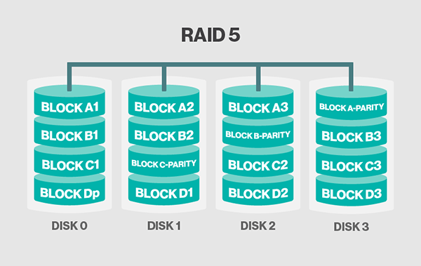
HDFS: replication (2)
Data storage
Hadoop 3: support to Erasure Coding (EC) as an alternative to simple replication
I.e., a mechanism similar to Redundant Array of Inexpensive Disks (RAID) 5-6
Each block is split (striped) across each data node
Works best for warm and cold datasets with relatively low I/O activities
Main advantages
Sensibly reduce data redundancy (from 200% to 50% with default setups)
Faster writes
Main disadvantages
Higher CPU cost
Longer recovery time in case of failure
Loss of data locality
Notes:
https://www.idata.co.il/2019/01/hadoop-3-erasure-coding-examined/

Slide 43
HDFS: not always the best fit
Data storage
Although this may change in the future, there are areas where HDFS is not a good fit today
Low-latency data access
HDFS is optimized for delivering a high throughput of data, and this may be at the expense of latency. Applications that require access to data in the tens of milliseconds range will not work well with HDFS.
Lots of small files
The limit to the number of files in a filesystem is governed by the amount of memory on the NN, because it holds filesystem metadata in memory.
Although storing millions of files is feasible, billions is beyond the capability of current hardware.

Slide 44
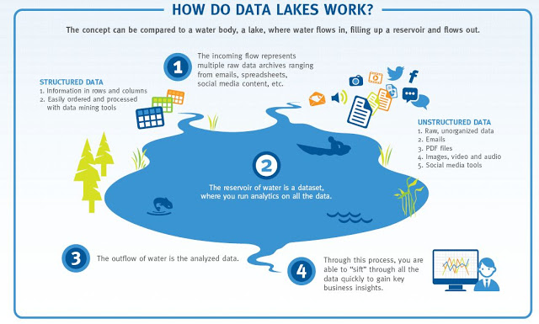
The data lake
Data storage
Big data stored in a DFS usually become a data lake
A central location that holds a large amount of data in its native, raw format
More on this the day after tomorrow...
Notes:
Data lakes were developed in response to the limitations of data warehouses. While data warehouses provide businesses with highly performant and scalable analytics, they are expensive, proprietary and can’t handle the modern use cases most companies are looking to address. Data lakes are often used to consolidate all of an organization’s data in a single, central location, where it can be saved “as is,” without the need to impose a schema (i.e. a formal structure for how the data is organized) up front like a data warehouse does. Data in all stages of the refinement process can be stored in a data lake: raw data can be ingested and stored right alongside an organization’s structured, tabular data sources (like database tables), as well as intermediate data tables generated in the process of refining raw data. Unlike most databases and data warehouses, data lakes can process all data types — including unstructured and semi-structured data like images, video, audio and documents — which are critical for today’s machine learning and advanced analytics use cases.

Slide 45
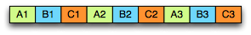
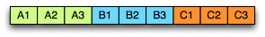
File formats
Data storage
Raw files
From simple text to multimedia files
No support besides reading/writing the whole file (e.g., no record compression, no splittability)
Row-oriented file formats
Apache Avro, Google’s Protocol Buffers, Facebook’s Apache Thrift
Better suited for row-level access to the data (e.g., OLTP)
Column-oriented file formats
Apache Parquet, ORC
Better suited for column-level access to the data (e.g., OLAP)
Better compression
Reduced I/O
Notes:
Instruction branching: http://stackoverflow.com/questions/5662261/why-is-it-good-to-avoid-instruction-branching-where-possible
Type specific encoding: https://discourse.looker.com/t/on-columnar-formats-and-encoding/2873
Dictionary encoding apparently not available on row-oriented storage https://pdfs.semanticscholar.org/1024/da80d950b8d3142ace378324644a67aa2d72.pdf

Slide 46
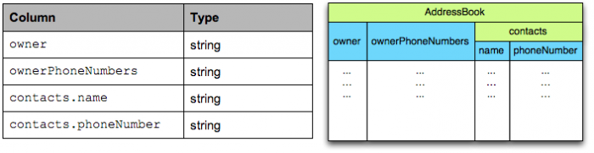
Parquet
Data storage
A columnar storage format for efficient querying of nested structures in a flat format
Supported by most frameworks and query engines
One column per primitive type
The structure of the record is captured for each value by two integers: repetition level and definition level
Enough to fully reconstruct the nested structures
Notes:
https://discuss.pivotal.io/hc/en-us/articles/212053948-Parquet-tables-Explained

Slide 47
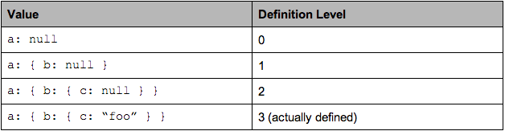
Parquet: definition level
Data storage
Needed in presence of optional nested fields
If there is a null value, at which level is it?
message ExampleDefLevel {
optional group a {
optional group b {
optional string c;
}
}
}
Notes:
Definition level: (from the right) which field is being defined NO if the field is not defined, which is the nesting level that is defined
Mi serve quando ho dei campi opzionali

Slide 48
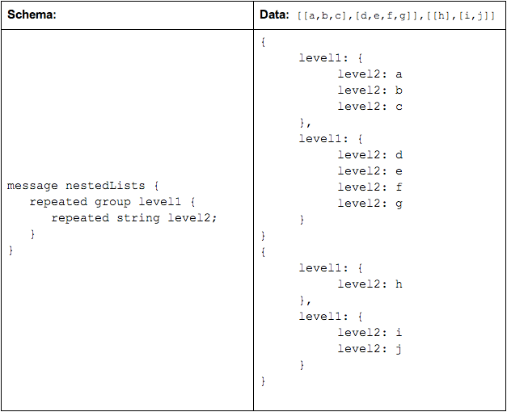
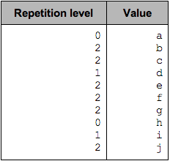
Parquet: repetition level
Data storage
Needed in presence of repeated fields (i.e., arrays)
To which array/record does the value belong to?
The repetition level can be seen as a marker of when to start a new list and at which level.
0 marks every new record; implies creating a new level1 and level2 list
1 marks every new level1 list; implies creating a new level2 list as well
2 marks every new element in a level2 list
Notes:
Repetition level: (from the left) which level is being repeated
Da dove parte la struttura sopra alla foglia relativa alla colonna attuale
Mi serve quando ho dei campi ripetibili

Slide 49
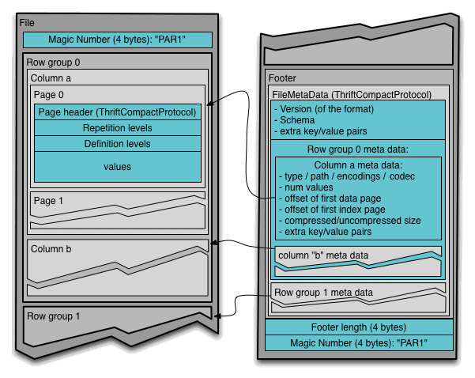
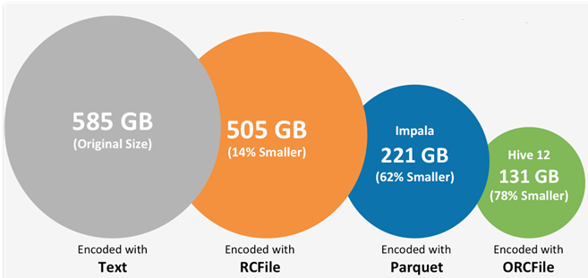
Parquet: storage and compression
Data storage
TPC-DS scale 500
Notes:
Repetition level: (from the left) which level is being repeated
Da dove parte la struttura sopra alla foglia relativa alla colonna attuale
Mi serve quando ho dei campi ripetibili

Slide 50
Distributed DB
Data storage
New types of databases have emerged

Slide 51
RDBMSs are full of strengths
Data storage
ACID properties
Provides guarantees in terms of consistency and concurrent accesses
Data integration and normalization of schemas
Several application can share and reuse the same information
Standard model and query language
The relational model and SQL are very well-known standards
The same theoretical background is shared by the different implementations
Robustness
Have been used for over 40 years

Slide 52
RDBMSs have weaknesses as well
Data storage
Impedance mismatch
Data are stored according to the relational model, but applications to modify them typically rely on the object-oriented model
Many solutions, no standard
E.g.: Object Oriented DBMS (OODBMS), Object-Relational DBMS (ORDBMS), Object-Relational Mapping (ORM) frameworks
Painful scaling-out
Not suited for a cluster architecture
Distributing an RDBMS is neither easy nor cheap (e.g., Oracle RAC)
Consistency vs latency
Consistency is a must – even at the expense of latency
Today's applications require high reading/writing throughput with low latency
Schema rigidity
Schema evolution is often expensive

Slide 53
What is "NoSQL"
Data storage
The term has been first used in '98 by Carlo Strozzi
It referred to an open-source RDBMS that used a query language different from SQL
In 2009 it was adopted by a meetup in San Francisco
Goal: discuss open-source projects related to the newest databases from Google and Amazon
Participants: Voldemort, Cassandra, Dynomite, HBase, Hypertable, CouchDB, MongoDB
Today, NoSQL indicates DBMSs adopting a different data model from the relational one
NoSQL = Not Only SQL
According to Strozzi himself, NoREL would have been a more proper noun

Slide 54
The first NoSQL systems
Data storage
LiveJournal, 2003
Goal: reduce the number of queries on a DB from a pool of web servers
Solution: Memcached, designed to keep queries and results in RAM
Google, 2005
Goal: handle Big Data (web indexing, Maps, Gmail, etc.)
Solution: BigTable, designed for scalability and high performance on Petabytes of data
Amazon, 2007
Goal: ensure availability and reliability of its e-commerce service 24/7
Solution: DynamoDB, characterized by strong simplicity for data storage and manipulation
Notes:
https://en.wikipedia.org/wiki/LiveJournal LiveJournal è una sorta di MSN russo

Slide 55
NoSQL common features
Data storage
Not just rows and tables
Several data model adopted to store and manipulate data
Freedom from joins
Joins are either not supported or discouraged
Freedom from rigid schemas
Data can be stored or queried without pre-defining a schema (schemaless or soft-schema)
Distributed, shared-nothing architecture
Trivial scalability in a distributed environment with no performance decay
Each workstation uses its own disks and RAM
Not a farewell to SQL

Slide 56
NoSQL data models
Data storage
NoSQL databases mainly differ by the supported data model
Model | Description | Use cases
Key-value | Associates any kind of value to a string | Dictionary, lookup table, cache, file and images storage
Document-based | Stores hierarchical data in a tree-like structure | Documents, anything that fits into a hierarchical structure
Wide-column | Stores sparse matrixes where a cell is identified by the row and column keys | Crawling, high-variability systems, sparse matrixes
Graph | Stores vertices and arches | Social network queries, inference, pattern matching

Slide 57
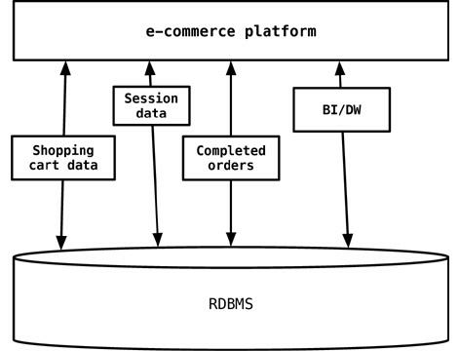
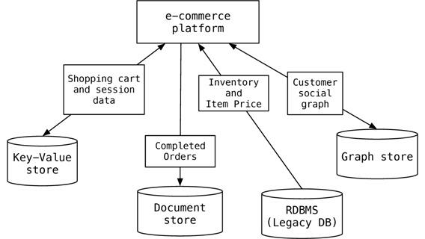
Polyglot persistence
Data storage
The one-size-fits-all is “no more”
More on this tomorrow...
Notes:
The session, shopping cart, or order data do not need the same properties of availability, consistency, or backup requirements. Does session management storage need the same rigorous backup/recovery strategy as the e-commerce orders data? Does the session management storage need more availability of an instance of database engine to write/read session data?
In 2006, Neal Ford coined the term polyglot programming, to express the idea that applications should be written in a mix of languages to take advantage of the fact that different languages are suitable for tackling different problems. Complex applications combine different types of problems, so picking the right language for each job may be more productive than trying to fit all aspects into a single language.

Slide 58
Data processing
Three main kinds of data processing
Batch
Interactive
Streaming

Slide 59
Batch
Simple/complex computations over large amounts of stored data
Execution takes minutes to hours
What we need
A cluster manager to negotiate resources
An execution engine

Slide 60
YARN
Batch processing
Yet Another Resource Negotiator
Usage: assign resources for applications to run their processes
Two daemons
Resource Manager (RM) - the master
The ultimate authority that arbitrates resources among all the applications
Node Managers (NM) - the slaves
Responsible for the allocation and monitoring of containers
RM
NM
NM
NM
NM
NM
NM
NM
NM
Cont2,4
Cont1, AMP1
Cont2,3
Cont2, AMP2
Cont2,1
Cont2,2
Cont1,1
Cont1,2
Notes:
Container = sorta di mini-VM (core and memory)

Slide 61
Data locality
Batch processing
Exploit cluster topology and data block replication to apply the data locality principle
When computations involves large set of data, it is cheaper (i.e. faster) to move code to data rather than data to code
The following cases respect the order the resource manager prefers:
Process and data on the same node
Process and data on the different node of the same rack
Process and data on different racks of the same data center
Process and data on different racks of the different data centers

Slide 62
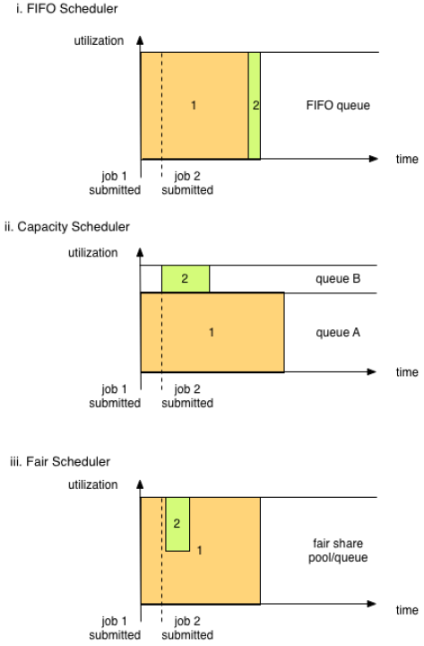
YARN: Scheduler
Batch processing
YARN provides a choice of schedulers and configurable policies
FIFO Scheduler
Simple to understand, no configuration needed
Not suitable for shared clusters
Capacity Scheduler (default)
Reserves a fixed amount of capacity to each job
Fair Scheduler
Dynamically balances the available resources between all running jobs
Notes:
Capacity: guarantee a minimum to everyone in the organization
Fair: everyone the same amount
Fair scheduling is a method of assigning resources to jobs such that all jobs get, on average, an equal share of resources over time. When there is a single job running, that job uses the entire cluster. When other jobs are submitted, tasks slots that free up are assigned to the new jobs, so that each job gets roughly the same amount of CPU time.
The CapacityScheduler is designed to allow sharing a large cluster while giving each organization a minimum capacity guarantee. The central idea is that the available resources in the Hadoop Map-Reduce cluster are partitioned among multiple organizations who collectively fund the cluster based on computing needs. There is an added benefit that an organization can access any excess capacity not being used by others. This provides elasticity for the organizations in a cost-effective manner.

Slide 63
Typical Large-Data Problem
Batch processing
Iterate over a large number of records
Extract something of interest from each
Shuffle and sort intermediate results
Aggregate intermediate results
Generate final output
Map
Reduce
Key idea: provide a functional abstraction for these two operations
Notes:
Paradigma di programmazione pensato per rispondere al tipo problema di analisi su big data, che coinvolge un grande quantitativo di dati e che solitamente segue più o meno lo stesso pattern

Slide 64
Roots in Functional Programming
Batch processing
MAP takes a function f and applies it to every element in a list,
FOLD iteratively applies a function g to aggregate results
MAP
f
f
f
f
f
FOLD
g
g
g
g
g
Notes:
MAP: è come applicare un ciclo FOR ed eseguire la stessa operazione su tutti gli elementi della lista; l'output può essere compost da più valori
FOLD/REDUCE: prendo un insieme di elementi con la stessa chiave e ci applico una determinate funzione per ricavare un unico valore

Slide 65
Parallelization of Map and Reduce
Batch processing
The map operation (i.e., the application of f to each item in a list) can be parallelized in a straightforward manner, since each functional application happens in isolation
In a cluster, these operations can be distributed across many different machines
The reduce operation has more restrictions on data locality
Elements in the list must be "brought together" before the function g can be applied
However, many real-world applications do not require g to be applied to all elements of the list. If elements in the list can be divided into groups, the fold aggregations can proceed in parallel.
Notes:
Due tipi di reduce: uno complessivo, uno per gruppi (groupByKey)
Reduce: non necessariamente reduce ad 1 valore finale, ma ad un sottoinsieme di quello iniziale (e.g., top 5; mi serve cmq il reduce, perchè nel map posso evere solo un top locale)

Slide 66
Disambiguation of MapReduce
Batch processing
"MapReduce is a programming model and an associated implementation for processing and generating large data sets.
Users specify a map function that processes a key/value pair to generate a set of intermediate key/value pairs, and a reduce function that merges all intermediate values associated with the same intermediate key."
-- Dean J., Ghemawat S. (Google)
Hadoop MapReduce is an open-source implementation of the MapReduce programming model

Slide 67
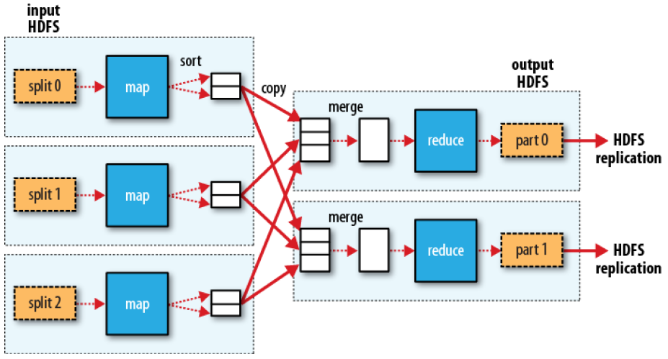
MapReduce process
Batch processing
Dotted boxes: nodes Light arrows: intra-node data transfers Heavy arrows: inter-node data transfers

Slide 68
Filtering pattern
Batch processing

Slide 69
Summarization pattern
Batch processing
Notes:
COSA C'E' DI SBAGLIATO?
groupB e D ripetuti

Slide 70
Join pattern
Batch processing

Slide 71
Sort
Batch processing
Goal: sort input
Examples:
Return all the domains indexed by Google and the number of pages in each, ordered by the number of pages
The programming model (map, then reduce) does not support this per se
But the implementations do: the shuffle stage performs grouping and ordering!
General pattern:
map (key, record) → emit (sortKey, record)
reduce (sortKey, records) → emit (sortKey, records[1]), ...
The Map and the Reduce do nothing
With 1 reducer, we get sorted output
With many reducers, we get partly sorted output (unless: TotalOrderPartitioner)
Notes:
Secondary sorting: https://www.quora.com/What-is-secondary-sort-in-Hadoop-and-how-does-it-work
TotalORderPartitioner: http://blog.ditullio.fr/2016/01/04/hadoop-basics-total-order-sorting-mapreduce/ Prima estrae un sample dei dati di input per capire che suddivisone creare, definisce le partizioni «ordinate», poi esegue il job normalmente

Slide 72
Two stage MapReduce
Batch processing
As map-reduce calculations get more complex, it’s useful to break them down into stages
The output of the first stage serves as input to the next one
The same output may be useful for different subsequent stages
The output can be stored in the DFS, forming a materialized view
Early stages of map-reduce operations often represent the heaviest amount of data access, so building and saving them once as a basis for many downstream uses saves a lot of work!

Slide 73
Data sharing in MapReduce
Batch processing
HDFS read
HDFS write
HDFS read
HDFS write
iter. 1
iter. 2
...
Input
HDFS read
query 1
result 1
query 2
result 2
Input
query 3
result 3
Slow due to data replication and disk I/O
...

Slide 74
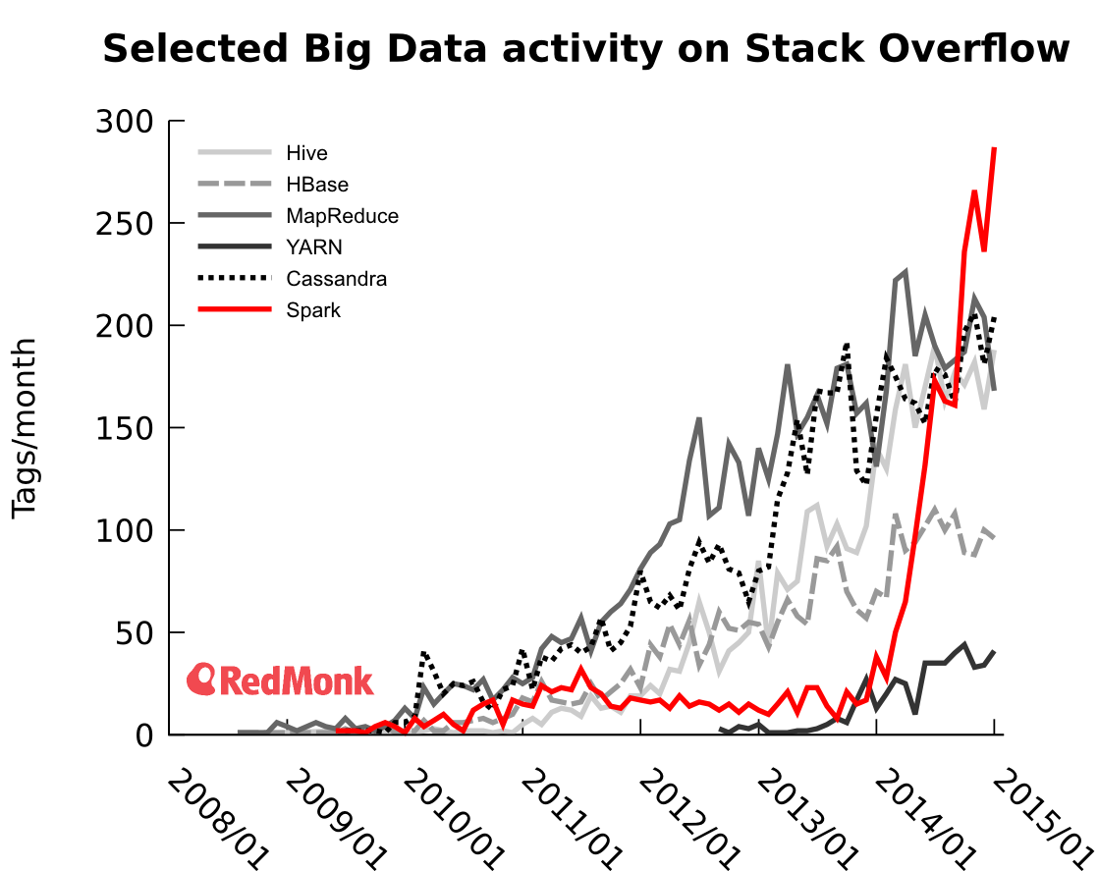
Spark
Batch processing
Spark project started in 2009
Developed at UC Berkeley’s AMPLab by Matei Zaharia
Originally built to test how Apache Mesos works
Open sourced 2010, Apache project from 2013
In 2014, Zaharia founded Databricks
Current version: 3.2
Written in Scala; supports Java and Python
Currently the most used tool for batch analyses
Notes:
The researchers in the lab had previously been working on Hadoop Map‐Reduce, and observed that MapReduce was inefficient for iterative and interactive computing jobs

Slide 75
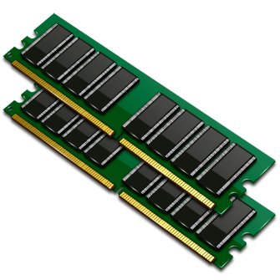
Data sharing in Spark
Batch processing
iter. 1
iter. 2
...
Input
query 1
result 1
one-time processing
query 2
result 2
Input
query 3
result 3
10-100× faster than network and disk
...

Slide 76
Spark pillars: RDD
Batch processing
RDDs are immutable distributed collection of objects
Resilient: automatically rebuild on failure
Distributed: the objects belonging to a given collection are split into partitions and spread across the nodes
RDDs can contain any type of Python, Java, or Scala objects
Distribution allows for scalability and locality-aware scheduling
Partitioning allows to control parallel processing
Fundamental characteristics (mostly from pure functional programming)
Immutable: once created, it can’t be modified
Lazily evaluated: optimization before execution
Cacheable: can persist in memory, spill to disk if necessary
Type inference: data types are not declared but inferred (≠ dynamic typing)
Notes:
Resilienza e distribuzione ci sono anche in MR, ma non c’è il concetto di dataset

Slide 77
Spark pillars: DAG
Batch processing
Based on the user application and on the lineage graphs, Spark computes a logical execution plan in the form of a DAG
Which is later transformed into a physical execution plan
The DAG (Directed Acyclic Graph) is a sequence of computations performed on data
Nodes are RDDs
Edges are operations on RDDs
The graph is Directed: transformations from a partition A to a partition B
The graph is Acyclic: transformations cannot return an old partition

Slide 78
Spark sample DAG
Batch processing
Word count in Scala
textFile = sc.textFile("hdfs://...")
counts = textFile.flatMap(line => line.split(" ")) .map(lambda word: (word, 1)) .reduceByKey(lambda a,b: a + b)
counts.saveAsTextFile("hdfs://...")
reduce ByKey
saveAs TextFile
textFile
flatMap
map

Slide 79
DAG decomposed into stages
Batch processing
The execution plan is compiled into physical stages
Stages’ boundaries are defined by shuffle operations
Operations with narrow dependencies are pipelined as much as possible
Stage 1
Stage 2
reduce ByKey
textFile
flatMap
map

Slide 80
Stages decomposed into tasks
Batch processing
The fundamental unit of execution is the one of tasks
A task is created for each partition in the new RDD
Tasks are scheduled and assigned to the worker nodes based on data locality
The scheduler can run the same task on multiple nodes in case of stragglers (i.e., slow nodes)
Stage 1
Stage 2
Task 1
Task 5
Task 2
Task 6
Task 3
Task 7
Task 4
reduce ByKey
textFile
flatMap
map
Notes:
Highlight the fact that shuffle outputs are spilled to disk?

Slide 81
Spark architecture
Batch processing
Spark uses a master/slave architecture with one central coordinator (driver) and many distributed workers (executors)
The driver and each executor are independent Java processes
Together they form a Spark application
The architecture is independent of the cluster manager that Spark runs on
Executor
tasks and data
Task
Task
Driver
resources request
Cluster Manager
resources
assignment
data
shuffling
SparkContext
Executor
tasks and data
Task
Task
Notes:
Driver can be run from the client (spark-shell) or from the AMP (for production)
https://spark.apache.org/docs/latest/running-on-yarn.html
"In cluster mode, the Spark driver runs inside an application master process which is managed by YARN on the cluster, and the client can go away after initiating the application. In client mode, the driver runs in the client process, and the application master is only used for requesting resources from YARN"

Slide 82
Spark architecture
Batch processing
Cluster Manager: the component responsible for assigning and managing the cluster’s resources (e.g., memory, processor time, …)
The cluster manager can be either the Spark standalone manager or any other compatible manager (e.g., YARN)
Launches executor processes on behalf of the driver
Executor
tasks and data
Task
Task
Driver
resources request
Cluster Manager
resources
assignment
data
shuffling
SparkContext
Executor
tasks and data
Task
Task

Slide 83
Spark architecture
Batch processing
Executor: a process responsible for executing the received tasks
Each spark application can have (and usually has) multiple executors, and each worker node can host many executors
Typically runs for the entire duration of the application
Stores (caches) RDD data in JVM heap
Tasks are the smallest unit of work and are carried out by executors
Executor
tasks and data
Task
Task
Driver
resources request
Cluster Manager
resources
assignment
data
shuffling
SparkContext
Executor
tasks and data
Task
Task
Notes:
run the tasks and provide in-memory storage for RDDs
First, they run the tasks that make up the application and return results to the driver. Second, they provide in-memory storage for RDDs that are cached by user programs, through a service called the Block Manager that lives within each executor. Because RDDs are cached directly inside of executors, tasks can run alongside the cached data.

Slide 84
Spark architecture
Batch processing
Driver Program (a.k.a. Spark Driver, or simply Driver)
Each spark application can only have one driver (entry point of Spark Shell)
Converts user program into tasks
Creates the SparkContext, i.e., the object that handles communications
Computes the logical DAG of operations and converts it into a physical execution plan
Schedules tasks on executors
Has a complete view of the available executors and schedules tasks on them
Stores metadata about RDDs and their partitions
Launches a webUI
Executor
tasks and data
Task
Task
Driver
resources request
Cluster Manager
resources
assignment
data
shuffling
SparkContext
Executor
tasks and data
Task
Task
Notes:
Driver: process where the main() runs.
It is the process running the user code that creates a SparkContext, creates RDDs, and performs transformations and actions. When you launch a Spark shell, you’ve created a driver program (if you remember, the Spark shell comes preloaded with a SparkContext called sc). Once the driver terminates, the application is finished.
When the driver runs, it performs two duties: Converting a user program into tasks and Scheduling tasks on executors
Why is scheduling handled by the Driver and not demanded to the Resource Manager:
data is iteratively queried in Spark; the driver knows where the data is cached, not the RM
in MR, containers are destroyed when a task is done; in Spark, an Executor stays alive. Thus, there's no need to continuously allocate containers

Slide 85
Spark architecture (in YARN)
Batch processing
Driver Program ≅ Application
Driver can be run externally from the client (e.g., spark-shell) or internally from the AMP (e.g., for production jobs)
The Application master process (AMP) is not shown for simplicity
Executor = Container
Executors are run and monitored by the Node Manager (NM)
Cluster Manager = Resource Manager (RM)
Executor
tasks and data
Task
Task
Driver
resources request
Cluster Manager
resources
assignment
data
shuffling
SparkContext
Executor
tasks and data
Task
Task
Notes:
Driver can be run from the client (spark-shell) or from the AMP (for production)
https://spark.apache.org/docs/latest/running-on-yarn.html
"In cluster mode, the Spark driver runs inside an application master process which is managed by YARN on the cluster, and the client can go away after initiating the application. In client mode, the driver runs in the client process, and the application master is only used for requesting resources from YARN"

Slide 86
Interactive
Simple computations over small/large amounts of stored data
Execution takes milliseconds to minutes
What we need
An MPP-like execution engine

Slide 87
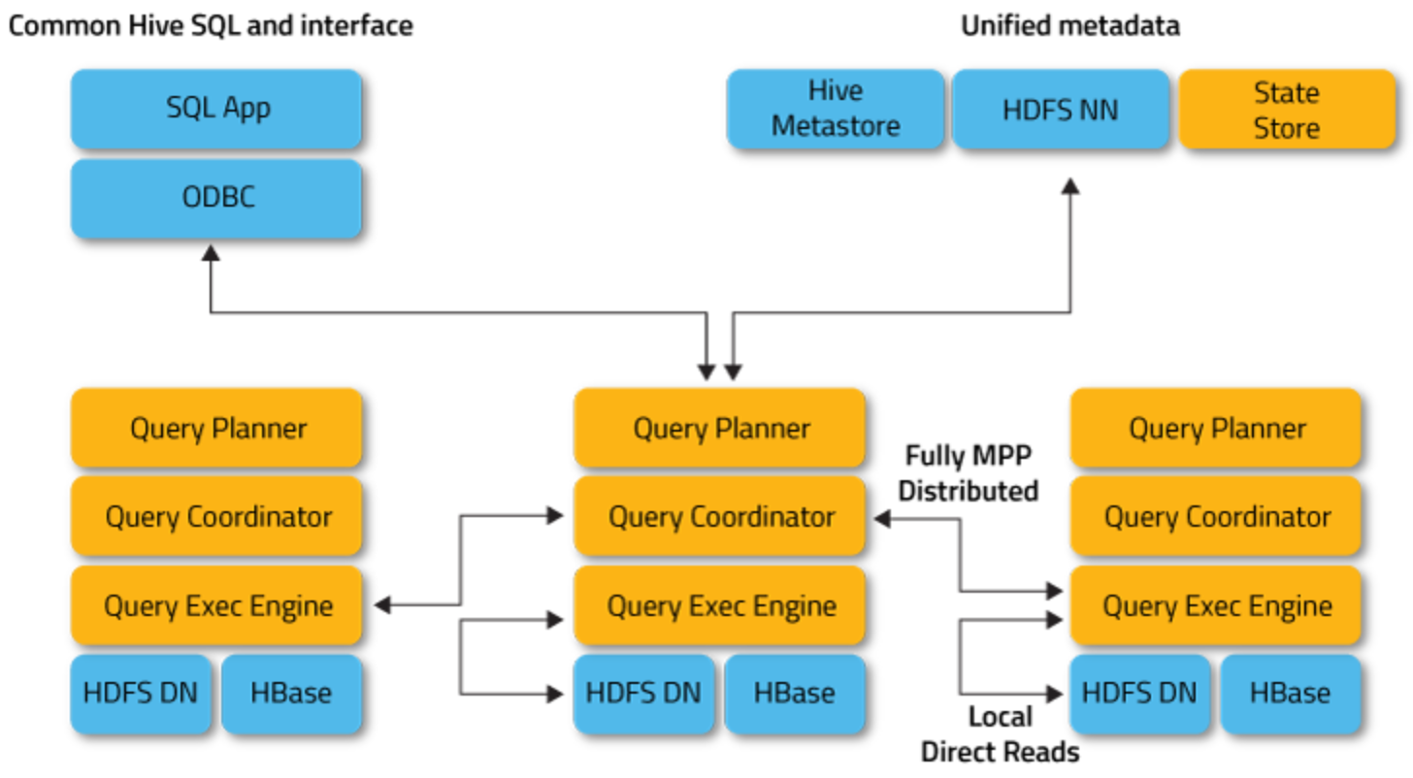
Interactive
Interactive processing
MPP-like architecture
Always-running daemons
Distributed engine: submit queries to any node
Highly rely on caching and in-memory computation
Optimistic query execution
Several tools
Apache Impala (from Cloudera)
Apache Presto (from Facebook)
Apache Drill

Slide 88
Streaming
Simple computations over small amounts of continuously incoming data
Execution is in near-real-time
What we need
A message queueing service
An execution engine

Slide 89
Streaming system definition
Streaming processing
The term "streaming" has been used to mean a variety of different things
Video streaming
Streaming systems
Streaming algorithms
In our context, a system for data streaming is
a type of data processing engine that is designed with infinite datasets in mind
Remember that
Batch engines can be (and have been) used to process infinite datasets
Streaming engines can be (and have been) used to process finite datasets
Notes:
Un sistema dedicato all'elaborazione dei dati e pensato, progettato per elaborare dataset infiniti.
DA MIGLIORARE

Slide 90
Data streaming characteristics
Streaming processing
Infinite dataset
Data is always being generated
No control over the order in which data elements arrive
Infinite computation
The system must be always on and must be able to keep up with the data
There must be a plan to avoid overflowing (e.g., auto-scalability)
Low-latency, approximate and/or speculative results
Data can usually be processed a single time (one pass)
Only a fraction of the dataset can be kept in memory for analyses
Approximation may be required to accommodate the low-latency requirement

Slide 91
Architecture
Streaming processing
Data producer
Data consumer
Collection
Analysis
Data access
Message queuing
(event-driven service bus)
Long term storage
In-memory storage

Slide 92
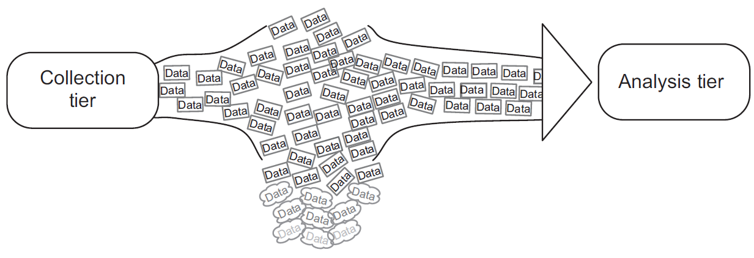
Message queuing tier
Streaming processing
The message queuing tier handles the transportation of data between different tiers
Most importantly, between collection to analysis tiers
Why message queuing?
By decoupling the pipeline of operations (collection, analysis, data access), each node in the cluster will do one job only
Message queuing provides a solid framework for a safe communication between such nodes
Message queuing handles funneling of n data streams to m consumers
Notes:
Funnel: imbuto
Funnelling: accodamento?

Slide 93
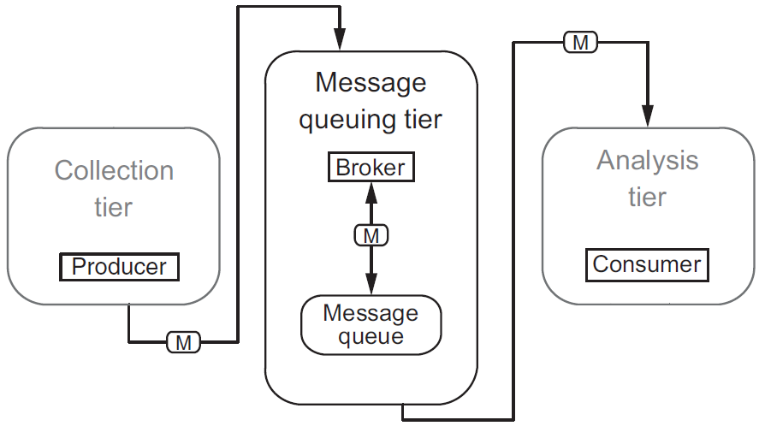
Producer-Broker-Consumer
Streaming processing
Core concepts
The Producer and the Consumer of data
The Broker, which manages one or more queues of data

Slide 94
Message delivery semantics
Streaming processing
Exactly once: a message is never lost and is read once and only once
Required in applications where data means money (financial/ad systems)
Performance is sacrificed to provide safety mechanisms
At most once: a message may get lost, but it will never be read twice
Allowed where not all data is required (monitoring systems, down-sampling)
Fast and trivial
At least once: a message will never be lost, but it may be read twice
Balances the two previous semantics
Easier to provide than exactly once
The consumer can still check for duplicates to adopt exactly once
Beware: guarantees depends on the chosen tools + application logic on the whole pipeline
Notes:
Che cosa sono le garanzie semantiche? Cercare una definizione. – livello di garanzia sulla consegna del messaggio
The general theory is that appropriate message handling, beyond ensuring that they are delivered at least once, is dependent on the application logic and should be handled at that level

Slide 95
Analysis: continuous queries
Streaming processing
A continuous query is a query that is issued once and then is continuously executed against the data
In contrast, traditional queries are simply executed once when issued
A continuous query may need to maintain a state
State: an intermediate result that is continuously updated by the query
A query is stateless if each execution is independent from the other
What makes continuous queries different from traditional ones?
Memory constraint (for both data processing and state maintenance)
Data cannot be processed altogether (one pass algorithms)
Not much space to store the state
Time constraint
Data that can't be processed in time may have to be dropped (load shedding)
Algorithms (e.g., predictive models) may lose efficacy over time (concept drift)
Notes:
NON SONO TUTTI MEMORY CONSTRAINT
[SD qua e là]
[thus] Input data is processed either on a per-tuple or per-window basis
one pass: can't iterate on the data, would require too much memory
since I'm computing one piece at a time, I need to know how to aggregate it

Slide 96
Continuous query model
Streaming processing
 | Typical query | Continuous query
Query model | Queries are based on a one-time model and a consistent state of the data Pull model: the user executes a query and gets an answer, and the query is forgotten | The query is continuously executed based on the data that is flowing into the system Push model: a user registers a query once, and the results are regularly pushed to the client
Query state | If the system crashes while a query is being executed, it must be re-issued on the whole dataset | Registered continuous queries may or may not need to continue where they left off; in the first case, a state has to be maintained
Notes:
[SD]

Slide 97
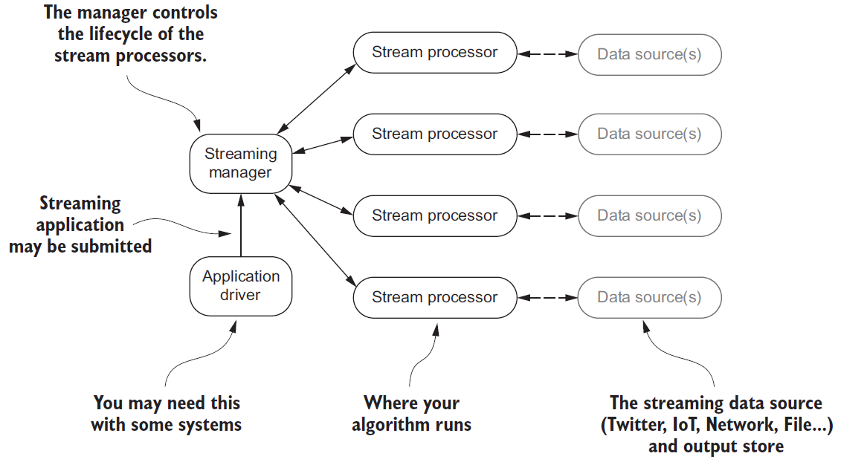
Distributed execution
Streaming processing
An architecture that is common to different frameworks

Slide 98
Sliding windows
Streaming processing
Sliding windows define length and period in terms of stream time
Beware of the difference between event time and stream time
Depending on the comparison of length and period, specialized versions of sliding windows can be defined
Fixed windows: when length and period are the same
E.g.: analyze the last 5 minutes of data every 5 minutes
Tumbling windows are a special case of fixed windows, where length and period are expressed in terms of number of items (instead of time)
Overlapping windows: when the length is greater than the period
E.g.: analyze the last 5 minutes of data every 2 minutes
Sampling windows: when the length is smaller than the period
E.g.: analyze the last 2 minutes of data every 5 minutes

Slide 99
Data-driven windows
Streaming processing
Data-driven windows define the length in terms of the content that comes with the data
In this case, the period determines the update interval
Typical use case: sessions
A session is a sequence of events terminated by a gap of inactivity grater than some timeout
Goal: determine the average amount of traffic generated by sessions
Main characteristic: the lengths cannot be defined apriori
How can I know when the session of a user has ended?
How can I know when the event of a user's session are going to stop coming?

Slide 100
Algorithms
Streaming processing
Consider n the space of events captured by the data stream
Streaming algorithm have the following requirements:
One-pass; once examined, items must be discarded
Use small space for the internal state: ( O(polylog(n)) )
Fast update of the internal state: O(1) to O(polylog(n))
Fast computation of answers
Provide approximated answers with (ε, δ)-guarantees
Let R be the exact result, ε and δ > 0
With probability at least 1 − δ, the algorithm outputs R' such that (1 − ε)R ≤ R' ≤ (1 + ε)R
For instance, take ε=0.02 and δ=0.01
Then, I have a 99% probability that the obtained result R’ equals the real result ± 2%
Notes:
[One-Pass Streaming Algorithms] polylog(n) = (log n)^k
https://stackoverflow.com/questions/1801135/what-is-the-meaning-of-o-polylogn-in-particular-how-is-polylogn-defined

Slide 101
Algorithms (examples)
Streaming processing
Given any list as an input
Count the number of elements
Find the n^{th} element
Given a list of numbers
Find the k largest or smallest elements (k given in advance)
Find the sum/mean/variance/st.dev. of the elements of the list
Given a list of symbols from an alphabet of k symbols (given in advance)
Count the number of times each symbol appears in the input (frequency)
Find the most or least frequent elements (heavy hitters)
Sort the list according to some order on the symbols
Find the maximum gap between two appearances of a given symbol
Notes:
Wikipedia: la solvibilità di questi algoritmi è legata al fatto che per «one-pass» si intendono algoritmi che hanno storage<O(n) e O(1) di update – motivo per cui, quelli che non sono solvibili, non lo sono perché non possono tenere tutta la lista in memoria

Slide 102
Algorithms (examples)
Streaming processing
Some problems are not solvable by one-pass algorithms
Given any list as an input
Find the middle element of the list
Given a list of numbers
Find the median
Find the most frequent symbol
Sort the list

Slide 103
Approximated algorithms
Streaming processing
Analyzing a data stream is challenging due to:
Space constraints
Time constraints
Algorithm unfeasibility in one-pass
One solution is to rely on approximated algorithms
Approximation can be achieved by relying on two main concepts:
Sampling
Random projections

Slide 104
Approximation by sampling
Streaming processing
Many different sampling methods have been proposed
E.g., Distinct sampling, Quantile sampling, Reservoir sampling
Sampling algorithms are known on time series and cash register models to
Find the number of distinct items
Find the quantiles
Find frequent items
Notes
Some systems (e.g., IP packet sniffers) already do sampling
Sampling is not a powerful primitive for many problems
Too many samples for performing sophisticated analyses
Sampling is more challenging in the turnstile model
Notes:
[Data Streams - Algorithms and Applications (partial)]
Con 1 - One needs far too many samples for performing sophisticated analyses. See [86] for some lower bounds. (B stream-1.1)
Con 2 - As stream unfolds, if the samples maintained by the algorithm get deleted, one may be forced to resample from the past, which is in general, expensive or impossible in practice and in any case, not allowed in data stream models. Some work on this issue: https://arxiv.org/pdf/1209.5566.pdf

Slide 105
Approximation with random projections
Streaming processing
An approach that relies on dimensionality reduction, using projection along random vectors
Project high-dimensional data into a suitable lower-dimensional space..
..in a way which approximately preserves the distances between the points
Projections are called sketches
Random projection algorithms are known on (also) turnstile models to
Estimate the number of distinct elements at any time
Estimate the quantiles at any time
Track most frequent items, wavelets, histograms, etc.
Random subset sums, counting sketches, Bloom filters
Notes:
[Data Streams - Algorithms and Applications (partial)]
https://en.wikipedia.org/wiki/Random_projection

Slide 106
Reference architectures
A stack of many components
NIST’s reference
Microsoft’s reference
Coexistence of batch and streaming (Lambda vs Kappa)
The technological stack

Slide 107
NIST's reference
Architectures
Notes:
Riferimento concettuale per le progettazione di un’architettura

Slide 108
NIST's reference
Architectures
System Orchestrator
Integrate the required application activities into an operational vertical system
Configure and manage the other components of the Big Data architecture to implement one or more workloads
Monitor workloads and system to verify the meeting of quality requirements
Elastically assign and provision additional physical or virtual resources
Performed by human and/or software components
Notes:
https://segment.com/resources/data-strategy/what-is-data-orchestration/
https://itnext.io/orchestration-frameworks-for-big-data-cfb9d3af6e7e
https://www.advsyscon.com/blog/big-data-orchestration/
Data_Pipelines_with_Apache_Airflow.pdf
https://www.qubole.com/tech-blog/understand-apache-airflows-modular-architecture/
https://lakefs.io/the-state-of-data-engineering-in-2021/
Not exclusive to big data
Necessary to maintain control
Strongly tied to DataOps
Helps the collaboration

Slide 109
NIST's reference
Architectures
Data Provider
Introduces new data or information feeds into the Big Data system
It can be anything from a sensor to a human or another Big Data system
Includes the following activities:
Collecting and persisting the data
Providing transformation functions for scrubbing sensitive information
Creating the metadata describing the data source, usage policies/access rights, etc.
Enforcing access rights on data access and establishing (in)formal contracts for data access authorizations
Making the data accessible through suitable programmable push or pull interfaces and mechanisms
Publishing the availability of the information and the means to access it
Data Consumer
Uses the interfaces or services provided by the Big Data Application Provider to get access to the information of interest
It can be an actual end user or another Big Data system

Slide 110
NIST's reference
Architectures
Big Data Application Provider
Executes a specific set of operations along the data life cycle
Meet the requirements established by the System Orchestrator
Meet security and privacy requirements
Includes the following activities:
Collection, Preparation, Analytics, Visualization, Access
Each activity
Is specific to the application
Can be implemented by independent stakeholders and deployed as a stand-alone service
There may be multiple and differing instances of each activity, or a single program may perform multiple activities
Each of the functions can run on a separate Big Data Framework Provider or all can use a common Big Data Framework Provider

Slide 111
NIST's reference
Architectures
Big Data Framework Provider
Provides general resources or services to be used by the Big Data Application Provider in the creation of the specific application
Handles the communication with the Big Data Application Provider and the assignment of physical resources to the respective activities
Consists of Infrastructure frameworks..
Support the underlying computing, storage, and networking functions required to implement the overall system
Associated with physical or virtual infrastructure resources
.. Data Platform frameworks..
Manage the organization and distribution of data (file System, databases, etc.)
.. and Processing frameworks
How data will be processed in support of Big Data applications (e.g., batch/streaming framework)

Slide 112
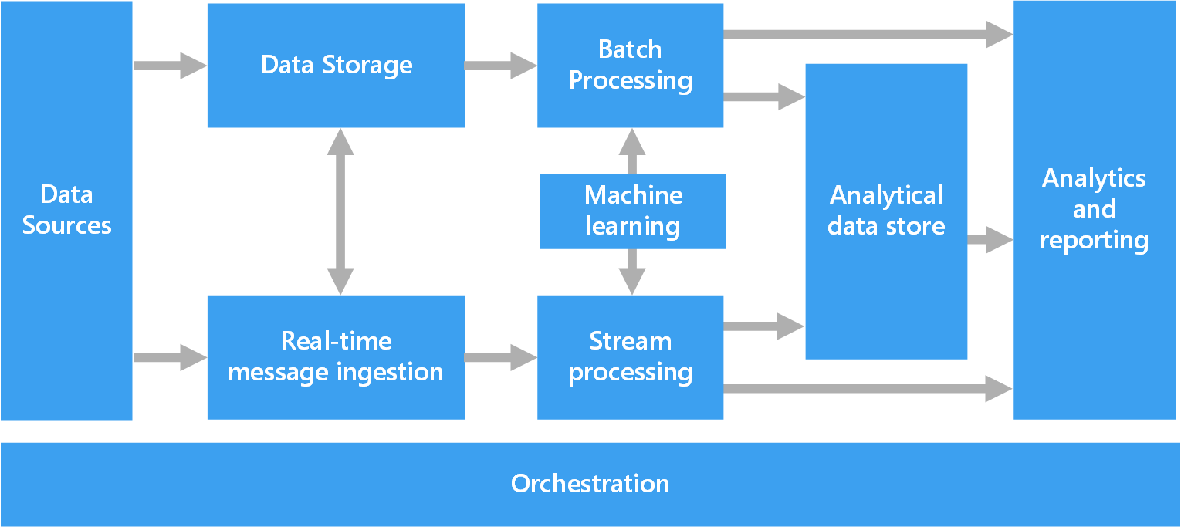
Microsoft's reference
Architectures
Logical components that fit into a big data architecture
Individual solutions may not contain every item

Slide 113
Microsoft's reference
Architectures
BD Application Provider
Data Provider
BD Framework Provider
BD Framework Provider
System Orchestrator

Slide 114
Microsoft's reference
Architectures
Data sources
Data stores, static files, real-time sources
Data storage
Distributed file store (data lake) or database
Batch processing
Long-running batch jobs to filter, aggregate, and prepare the data for analysis
Analytical data store
Serve the processed data in a structured format that can be queried using analytical tools
Analysis and reporting
Traditional OLAP and BI tools, interactive exploration, analytical notebooks

Slide 115
Microsoft's reference
Architectures
Real-time message ingestion
Capture and store real-time messages for stream processing
Act as a buffer for messages
Support scale-out processing, reliable delivery, message queuing semantics
Stream processing
Filter, aggregate, and prepare the data for analysis
Processed stream data is then written to an output sink
Orchestration
Automation of repeated data processing operations, encapsulated in workflows
E.g., transforming source data, moving data between multiple sources and sinks, loading into an analytical data store, pushing results to a dashboard

Slide 116
Lambda vs Kappa
Architectures
Batch and streaming analyses follow different principles
Batch: large amounts of data at-rest with fault-tolerance
Streaming: small amount of continuously incoming data without fault-tolerance
Two philosophies to make them coexist
Lambda
Kappa

Slide 117
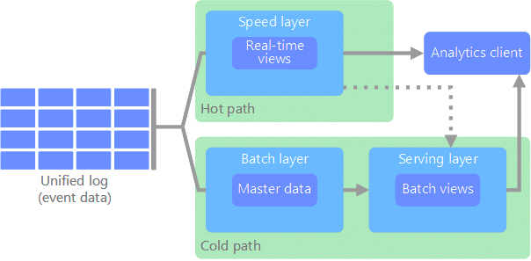
Lambda architecture
Architectures
All data coming into the system goes through two paths
Hot path: for timely, yet potentially less accurate data in real time
Cold path: for less timely but more accurate data

Slide 118
Lambda architecture
Architectures
Pros of Lambda
Emphasizes retaining the input data unchanged
Highlights the problem of reprocessing data (bugs, evolution, etc.)
Cons of Lambda
Parallel development and maintenance of two parallel pipelines
Same goal, different languages, different frameworks

Slide 119
Streaming: a superset of batch
Architectures
Can we do better?
Well-designed streaming systems provide a strict superset of batch functionality
Introduce correctness (exactly-once semantics, strong consistency) and the result of a streaming job is the same of batch job
A streaming engine can handle a bounded dataset

Slide 120
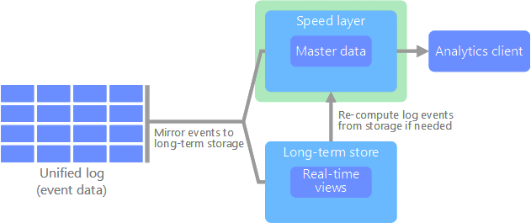
Kappa architecture
Architectures
All data flows through a single path, using a stream processing system
Similar to a lambda architecture's speed layer, all event processing is performed on the input stream and persisted as a real-time view
To recompute the entire data set (equivalent to what the batch layer does in lambda), simply replay the stream

Slide 121
Kappa architecture
Architectures
Modeling everything under the streaming paradigm is not trivial
Advanced tools provide a single framework and unified APIs for writing and executing both batch and streaming jobs
Google Cloud Dataflow
Apache Flink
“Broad maturation of streaming systems combined with robust frameworks for unbounded data processing will in time allow for the relegation of the Lambda Architecture to the antiquity of big data history where it belongs”

Slide 122
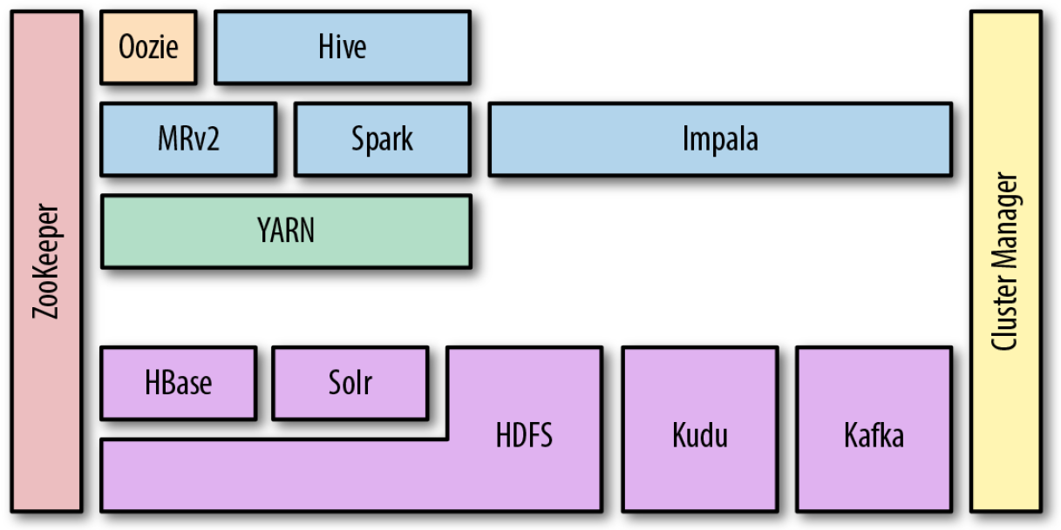
The technological stack
Architectures
Sample Hadoop-based deployment

Slide 123
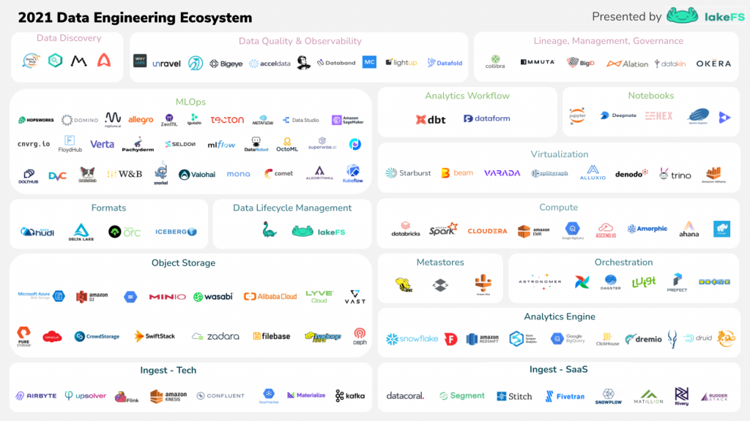
The technological stack
Architectures
Beyond Hadoop

Slide 124
On-premises vs cloud
Architectures
First installations where primarily on-premises
Installation: how do I set up a new machine?
Networking: how do I cable dozens of machines?
Management: how do I replace a broken disk?
Upgrade: how do I extend the cluster with new services/machines?
(energy and cooling, software licenses, insurance...)
Today, cloud providers are mature and offer comprehensive support for big data ecosystems
Forget all that is above

Slide 125
Cloud computing
Architectures
A model for enabling ubiquitous, convenient, on-demand network access to a shared pool of configurable computing resources (e.g., networks, servers, storage, services) that can be rapidly provisioned and released with minimal management effort or service provider interaction
On-demand self-service (consume services when you want)
Broad network access (consume services from anywhere)
Broad network deployment (deploy services anywhere)
Resource pooling (infrastructure, virtual platforms, and applications)
Rapid elasticity (enable horizontal scalability)
Measured service (pay for the service you consume as you consume)
Reliability (fault-tolerance handled by the provider)
Notes:
Service integration and abstraction?

Slide 126
Conclusions
Learned the basis of big data (a summary of the Master’s degree course)
Definitions and motivations
Main components – focus on storage and processing
Hardware and software architectures
Up next: an overview of some of the main challenges
Polyglot persistence
The metadata challenge
Notes:
https://segment.com/resources/data-strategy/what-is-data-orchestration/
https://itnext.io/orchestration-frameworks-for-big-data-cfb9d3af6e7e
https://www.advsyscon.com/blog/big-data-orchestration/
Data_Pipelines_with_Apache_Airflow.pdf
https://www.qubole.com/tech-blog/understand-apache-airflows-modular-architecture/
https://lakefs.io/the-state-of-data-engineering-in-2021/

Slide 127
Data platforms

Slide 128
What we are going to do
Definitions: from the data lake to the data platform
Define challenges
Discuss current solutions and future directions

Slide 129
Data platform
Companies are collecting tons of data to enable advanced analytics
Raw data is difficult to obtain, interpret, and maintain
Data is more and more heterogeneous
There is need for curating data to make it consumable
Where are we collecting/processing data?
Getting value from data is not (only) a matter of storage
Need integrated and multilevel analytical skills and techniques

Slide 130
Data platform
Getting value from data is not (only) a matter of storage
Any example?
“It is a capital mistake to theorize before one has data. Insensibly, one begins to twist the facts to suit theories, instead of theories to suit facts.”
– Sherlock Holmes

Slide 131

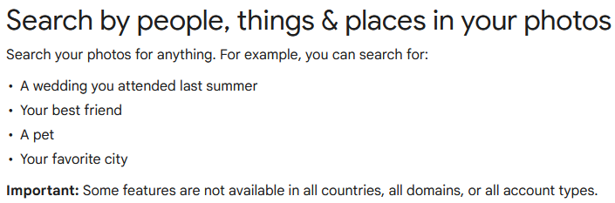
Case study: photo gallery

Slide 132
Data platform
Database
"A database is a structured and persistent collection of information about some aspect of the real world organized and stored in a way that facilitates efficient retrieval and modification. The structure of a database is determined by an abstract data model. Primarily, it is this structure that differentiates a database from a data file."
Relational
fk1 | pk | fk2
pk
pk
Özsu M.T. (2018) Database. In: Encyclopedia of Database Systems. Springer, New York, NY. https://doi.org/10.1007/978-1-4614-8265-9_80734

Slide 133
Data platform
Data Warehouse
"A collection of data that supports decision-making processes. It provides the following features: subject-oriented, integrated and consistent, not volatile."
Relational
DWH
(ROLAP)
From DB to DWH
ETL
Operational (relational) databases
Matteo Golfarelli and Stefano Rizzi. Data warehouse design: Modern principles and methodologies. McGraw-Hill, Inc., 2009.

Slide 134
Data platform: OLTP vs OLAP

Slide 135
Data platform: OLTP vs OLAP
Characteristic | OLTP | OLAP
Nature | Constant transactions (queries/updates) | Periodic large updates, complex queries
Examples | Accounting database, online retail transactions | Reporting, decision support
Type | Operational data | Consolidated data
Data retention | Short-term (2-6 months) | Long-term (2-5 years)
Storage | Gigabytes (GB) | Terabytes (TB) / Petabytes (PB)
Users | Many | Few
Protection | Robust, constant data protection and fault tolerance | Periodic protection

Slide 136
Data platform
From RELATIONAL to SCHEMALESS
Big data Vs?
Relational
NoSQL (Non relational)
DWH
(ROLAP)
[{
"_id": 1,
“firstname": “Alice”
}, {
"_id": 2,
“name": “Bob”
}]
Document
[
(“k1”, “v1),
(“k2”, “v2)
]
ETL
Key-value
Graph
Operational (relational) databases

Slide 137
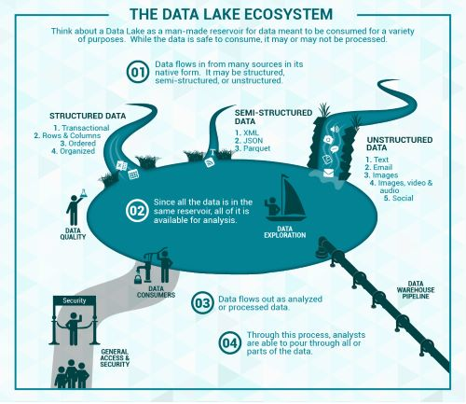
Data platform
Data lake
Couto et al.: “A DL is a central repository system for storage, processing, and analysis of raw data, in which the data is kept in its original format and is processed to be queried only when needed. It can store a varied amount of formats in big data ecosystems, from unstructured, semi-structured, to structured data sources”
Couto, Julia, et al. "A Mapping Study about Data Lakes: An Improved Definition and Possible Architectures." SEKE. 2019. https://dunnsolutions.com/business-analytics/big-data-analytics/data-lake-consulting

Slide 138

Data platform
Relational
NoSQL (Non relational)
Storage of Raw Data
DWH
(ROLAP)
[{
"_id": 1,
“firstname": “Alice”
}, {
"_id": 2,
“name": “Bob”
}]
Document
[
(“k1”, “v1),
(“k2”, “v2)
]
ETL
Key-value
Raw
Graph
Operational (relational) databases
Data Lake

Slide 139
Data lake
Definitions
“If you think of a datamart as a store of bottled water – cleansed and packaged and structured for easy consumption – the data lake is a large body of water in a more natural state.”
James Dixon, 2010
“A large storage system for raw, heterogeneous data, fed by multiple data sources, and that allows users to explore, extract and analyze the data.”
Sawadogo, P., Darmont, J. On data lake architectures and metadata management. J Intell Inf Syst 56, 97–120 (2021)
“A data lake is a central location that holds a large amount of data in its native, raw format.”
Databricks, 2021
Notes:
Data lakes were developed in response to the limitations of data warehouses. While data warehouses provide businesses with highly performant and scalable analytics, they are expensive, proprietary and can’t handle the modern use cases most companies are looking to address. Data lakes are often used to consolidate all of an organization’s data in a single, central location, where it can be saved “as is,” without the need to impose a schema (i.e. a formal structure for how the data is organized) up front like a data warehouse does. Data in all stages of the refinement process can be stored in a data lake: raw data can be ingested and stored right alongside an organization’s structured, tabular data sources (like database tables), as well as intermediate data tables generated in the process of refining raw data. Unlike most databases and data warehouses, data lakes can process all data types — including unstructured and semi-structured data like images, video, audio and documents — which are critical for today’s machine learning and advanced analytics use cases.

Slide 140
Data lake
Definitions
The data lake started with the Apache Hadoop movement, using the Hadoop File System (HDFS) for cheap storage
Schema-on-read architecture
Agility of storing any data at low cost
Eludes the problems of quality and governance
A two-tier data lake + warehouse architecture is dominant in the industry
HDFS replaced by cloud data lakes (e.g., S3, ADLS, GCS)
Data lake data directly accessible to a wide range of analytics engines
A subset of data is "ETL-ed" to a data warehouse for important decision support and BI apps
Armbrust, M., Ghodsi, A., Xin, R., & Zaharia, M. (2021). Lakehouse: A New Generation of Open Platforms that Unify Data Warehousing and Advanced Analytics. CIDR.

Slide 141
Example of data platform: Hadoop-based
A data platform on the Hadoop stack requires several tools
How many levels of complexity are hidden here?
How do you provision it?
Manual provisioning on-premises
Semi-automatic provisioning on-premises
Automatic provisioning in the cloud
Storage .
Resources .
Application .
GUI .
Messaging .
Orchestration .
Hue
Pig
Hive
Phoenix
Map Reduce
Batch
Spark
in mem
Flink
real-time
Others…
Impala
MPP
Kafka
Airflow
Zookeeper
HBASE
NoSQL
YARN
HDFS
NoSQL

Slide 142
Data platform: DWH vs Data Lake

Slide 143
Data platform: DWH vs Data Lake
Characteristics | Data warehouse | Data lake
Data | Relational | Non-relational and relational
Schema | Designed prior to implementation (schema-on-write) | Written at the time of analysis (schema-on-read)
Price/ performance | Fastest query results using higher cost storage | Query results getting faster using low-cost storage
Data quality | Highly curated data that serves as the central version of the truth | Any data, which may or may not be curated (e.g., raw data)
Users | Business analysts | Data scientists, data developers, and business analysts (using curated data)
Analytics | Batch reporting, BI, and visualizations | Machine learning, predictive analytics, data discovery, and profiling.

Slide 144
Data lake
Definitions
Downsides of data lakes
Security
All the data is stored and managed as files
No fine-grained access control on the contents of files, but only coarse-grained access governing who can access what files or directories
Quality
Hard to prevent data corruption and manage schema changes
Challenging to ensure atomic operations when writing a group of files
No roll-back mechanism
Query performance
Formats are not optimized for fast access
It is often said that the lake easily turns into a swamp

Slide 145
Data platform: DWH
Reduce stress on operational systems
Integrate data sources
No IT involvement to create reports
One version of the truth
Make better business decisions

Slide 146
Data platform
Data lakes have increasingly taken the role of data hubs
Eliminate up-front costs of ingestion and ETL since data are stored in original format
Once in DL, data are available for analysis by everyone in the organization
Drawing a sharp line been storage/computation/analysis is hard
Is a database just storage?
What about SQL/OLAP?
Blurring of the architectural borderlines
DL is often replaced by “data platform” or “data ecosystem”
Encompass systems supporting data-intensive storage, computation, analysis

Slide 147
Data platform
Data platform
An integrated set of technologies that collectively meets an organization’s end-to-end data needs such as acquisition, storage, preparation, delivery, and governance, as well as a security layer for users and applications
Rationale: relieve users from complexity of administration and provision
Not only technological skills, but also privacy, access control, etc.
Users should only focus on functional aspects

Slide 148
Data platform
We have services
To transform data
To support the transformation
The (DIKW) pyramid abstracts many techniques and algorithms
Standardization
Integration
Orchestration
Accessibility through APIs
Wisdom
Data
transformation
Supporting services
Serve (deciding/consume)
•
SQL
•
BI tools (e.g., Tableau)
Knowledge
Analytics (analyzing/process)
Storage
•
Processing
(organizing)
Security
Information
•
File
•
Access Control
Networking, etc.
•
Batch
•
Authorization
Computing
•
Streaming
•
Object
•
Machine learning
•
DB
Data
Ingestion (acquiring/collect)
•
Batch
World
•
Streaming

Slide 149
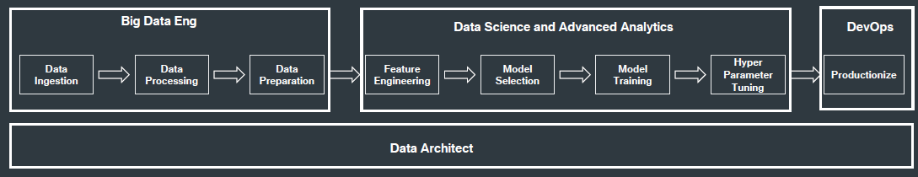
Data platform

Slide 150

Data lakehouse
Definitions
The data lakehouse enables storing all your data once in a data lake and efficiently doing AI and BI on that data directly at a massive scale
ACID transaction support
Schema enforcement
Data governance
All processes ensuring that data meet high quality standards throughout the whole lifecycles
Including availability, usability, consistency, integrity, security
Support for diverse workloads (e.g., data science, ML, SQL, analytics)
https://databricks.com/blog/2020/01/30/what-is-a-data-lakehouse.html
Notes:
http://cidrdb.org/cidr2021/papers/cidr2021_paper17.pdf
Data lakes were developed in response to the limitations of data warehouses. While data warehouses provide businesses with highly performant and scalable analytics, they are expensive, proprietary and can’t handle the modern use cases most companies are looking to address. Data lakes are often used to consolidate all of an organization’s data in a single, central location, where it can be saved “as is,” without the need to impose a schema (i.e. a formal structure for how the data is organized) up front like a data warehouse does. Data in all stages of the refinement process can be stored in a data lake: raw data can be ingested and stored right alongside an organization’s structured, tabular data sources (like database tables), as well as intermediate data tables generated in the process of refining raw data. Unlike most databases and data warehouses, data lakes can process all data types — including unstructured and semi-structured data like images, video, audio and documents — which are critical for today’s machine learning and advanced analytics use cases.

Slide 151
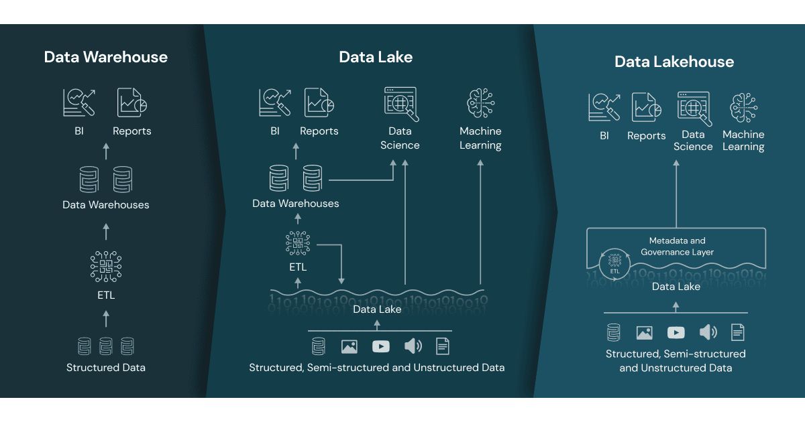
Data lakehouse
Data lakehouse
Data management architecture that combines the flexibility, cost-efficiency, and scale of data lakes with the data management and ACID transactions of data warehouses, enabling business intelligence (BI) and machine learning (ML) on all data
Vendor lock in
https://www.databricks.com/glossary/data-lakehouse

Slide 152
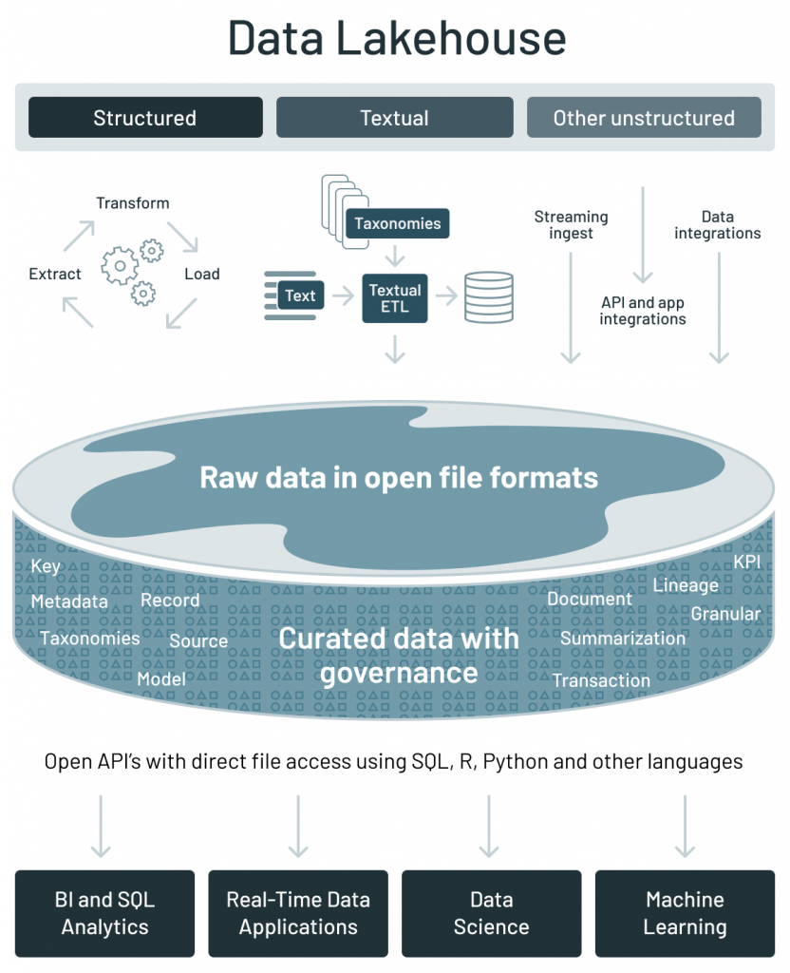
Data lakehouse
 | Data warehouse | Data lake | Data lakehouse
Data format | Closed, proprietary format | Open format (e.g., Parquet) | Open format
Types of data | Structured data, with limited support for semi-structured data | All types: Structured data, semi-structured data, textual data, unstructured (raw) data | All types: Structured data, semi-structured data, textual data, unstructured (raw) data
Data access | SQL-only, no direct access to file | Open APIs for direct access to files with SQL, R, Python and other languages | Open APIs for direct access to files with SQL, R, Python and other languages
Reliability | High quality, reliable data with ACID transactions | Low quality, data swamp | High quality, reliable data with ACID transactions
Governance and security | Fine-grained security and governance for row/columnar level for tables | Poor governance as security needs to be applied to files | Fine-grained security and governance for row/columnar level for tables
Performance | High | Low | High
Scalability | Scaling becomes exponentially more expensive | Scales to hold any amount of data at low cost, regardless of type | Scales to hold any amount of data at low cost, regardless of type
Use case support | Limited to BI, SQL applications and decision support | Limited to machine learning | One data architecture for BI, SQL and machine learning
Key technologies used to implement open source Data Lakehouses
Databricks’ Delta Lake
Apache Hudi
Apache Iceberg
https://databricks.com/blog/2021/05/19/evolution-to-the-data-lakehouse.html

Slide 153
Data fabric
Frictionless access and sharing of data in a distributed data environment
Enables a single and consistent data management framework, which allows seamless data access and processing by design across otherwise siloed storage
Leverages human and machine capabilities to access data in place or support its consolidation where appropriate
Continuously identifies and connects data from disparate applications to discover unique, business-relevant relationships between the available data points
It is a unified architecture with an integrated set of technologies and services
Designed to deliver integrated and enriched data – at the right time, in the right method, and to the right data consumer – in support of both operational and analytical workloads
Combines key data management technologies – such as data catalog, data governance, data integration, data pipelining, and data orchestration
Gartner, 2019 https://www.gartner.com/en/newsroom/press-releases/2019-02-18-gartner-identifies-top-10-data-and-analytics-technolo Gartner, 2021 https://www.gartner.com/smarterwithgartner/data-fabric-architecture-is-key-to-modernizing-data-management-and-integration K2View Whitepaper: What is a Data Fabric? The Complete Guide, 2021

Slide 154
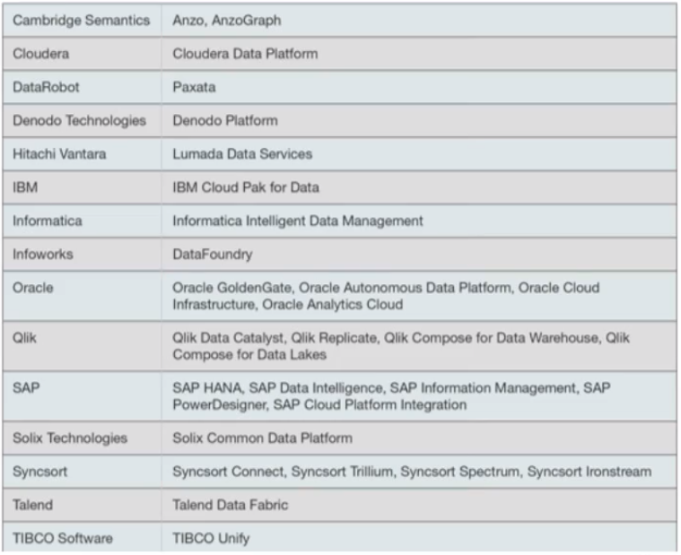
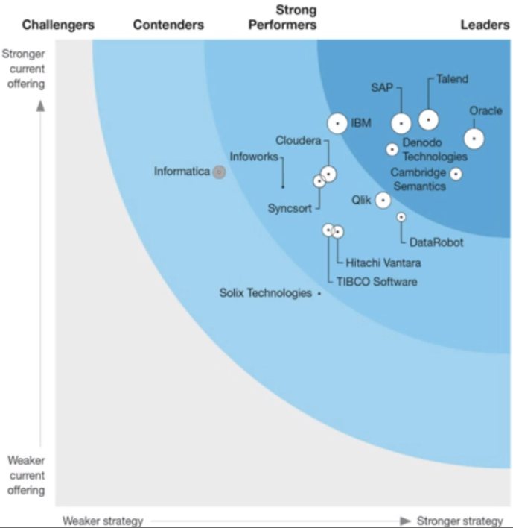
Data fabric
Definitions
It is a design concept
It optimizes data management by automating repetitive tasks
According to Gartner estimates, 25% of data management vendors will provide a complete framework for data fabric by 2024 – up from 5% today
Gartner, 2021 https://www.gartner.com/smarterwithgartner/data-fabric-architecture-is-key-to-modernizing-data-management-and-integration
K2View, 2021 https://www.k2view.com/top-data-fabric-vendors
Notes:
Top Players
https://solutionsreview.com/data-management/the-best-data-fabric-tools-and-software/
https://em360tech.com/top-10/data-modelling-fabric
Predictions
https://live-datastaxd8.pantheonsite.io/sites/default/files/2021-02/Predicts_2021_Data__735776_ndx.pdf

Slide 155
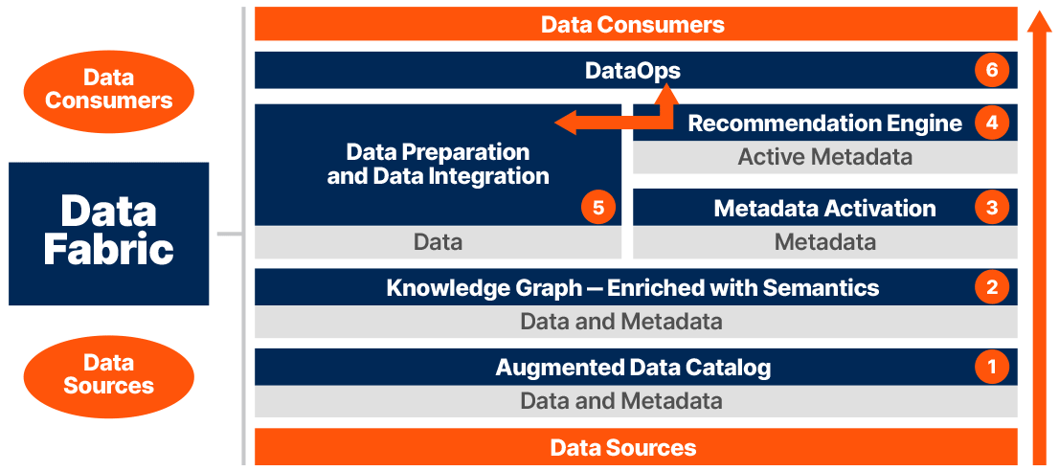
Data fabric
https://www.irion-edm.com/data-management-insights/gartner-data-summit-irion-representative-vendor-for-data-fabric-technology/

Slide 156
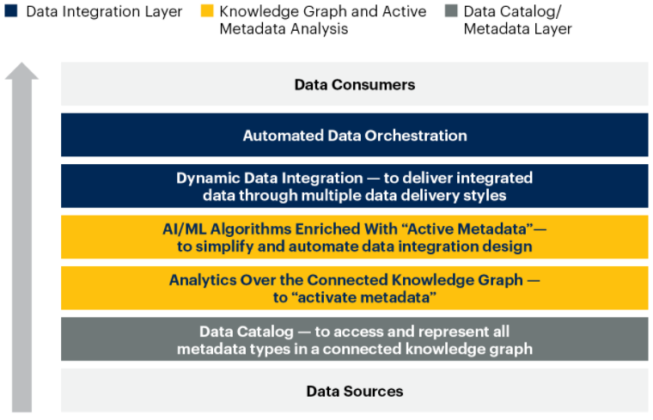
Data fabric
Gartner, 2021 https://www.gartner.com/smarterwithgartner/data-fabric-architecture-is-key-to-modernizing-data-management-and-integration

Slide 157
Data mesh
Distributed data architecture, under centralized governance and standardization for interoperability, enabled by a shared and harmonized self-serve data infrastructure
Domain-oriented decentralized data ownership
Decentralization and distribution of responsibility to people who are closest to the data, in order to support continuous change and scalability
Each domain exposes its own op/analytical APIs
Data as a product (quantum)
Products must be discoverable, addressable, trustworthy, self-describing, secure
Self-serve data infrastructure as a platform
High-level abstraction of infrastructure to provision and manage the lifecycle of data products
Federated computational governance
A governance model that embraces decentralization and domain self-sovereignty, interoperability through global standardization, a dynamic topology, automated execution of decisions by the platform
Zhamak Dehghani, 2019 https://martinfowler.com/articles/data-monolith-to-mesh.html Zhamak Dehghani, 2020 https://martinfowler.com/articles/data-mesh-principles.html
Notes:
https://www.youtube.com/watch?v=_bmYXWCxF_Q

Slide 158
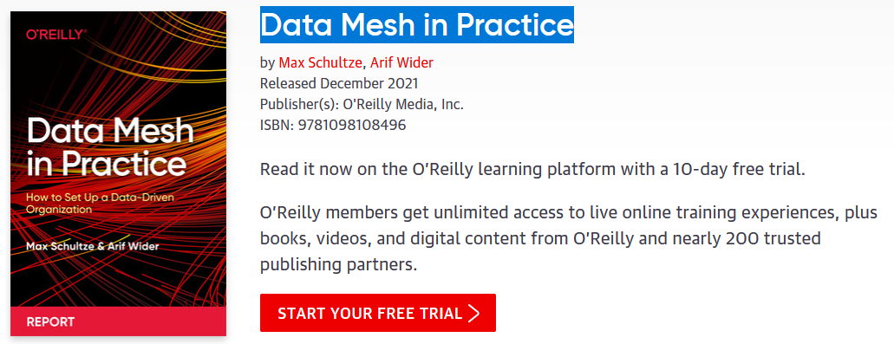
Data mesh

Slide 159
Data mesh vs data fabric
A data fabric and a data mesh both provide an architectural framework to access data across multiple technologies and platforms
Data fabric
Attempts to centralize and coordinate data management
Tackles the complexity of data and metadata in a smart way that works well together
Data mesh
Emphasis on decentralization and data domain autonomy
Focuses on organizational change; it is more about people and process
They are design concepts, not things
They are not mutually exclusive
They are architectural frameworks, not architectures
The frameworks must be adapted and customized to your needs, data, processes, and terminology
Gartner estimates 25% of data management vendors will provide a complete data fabric solution by 2024 – up from 5% today
Alex Woodie, 2021 https://www.datanami.com/2021/10/25/data-mesh-vs-data-fabric-understanding-the-differences/ Dave Wells, 2021 https://www.eckerson.com/articles/data-architecture-complex-vs-complicated

Slide 160
On-premises manual provisioning
Hardly advisable, if not for small and local tests
Technical challenges
Installation: how do I set up a new machine?
Networking: how do I cable dozens of machines?
Management: how do I replace a broken disk?
Upgrade: how do I extend the cluster with new services/machines?
(energy and cooling, software licenses, insurance...)
Technological challenges
How do we configure a distributed environment?
How do we set up/integrate/control independent services?
How do we orchestrate data flows?
Business challenges
Can we afford to spend resources on tasks that are not mission oriented?
No free lunch, each choice has cost/benefit
How much time does it take to master a technology?
How many people do I need?

Slide 161
Data platform: related job positions
Data platform engineer
Orchestrate the successful implementation of cloud technologies within the data infrastructure of their business
Solid understanding of impact database types and implementation
Responsible for purchasing decisions for cloud services and approval of data architectures
Data analyst
Analyze data systems, creating automated systems for retrieving data from the data platform
Cloud data analysts are more commonly members of the business user population
Data scientist
Analyze and interpret complex digital data
Work with new technologies (e.g., machine learning) to deepen the business' understanding and gain new insights
Data architect
Team members who understand all aspects of a data platform's architecture
Work closely with the data platform engineers to create data workflows
Responsible for designing and testing new database architectures and planning both data and architecture migrations
Data pipeline engineer
Responsible for planning, architecting, and building large-scale data processing systems

Slide 162
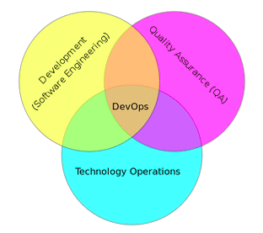
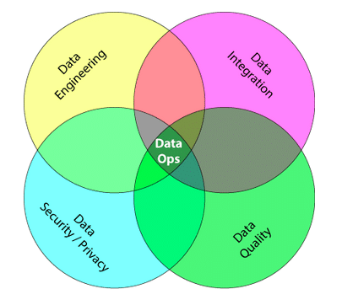
DataOps
From DevOps to DataOps
“A collaborative data management practice focused on improving the communication, integration and automation of data flows between data managers and data consumers across an organization”
Data analytics improved in terms of velocity, quality, predictability and scale of software engineering and deployment
Some key rules
Establish progress and performance measurements at every stage
Automate as many stages of the data flow as possible
Establish governance discipline (governance-as-code)
Design process for growth and extensibility
Gartner, 2020 https://www.gartner.com/smarterwithgartner/how-dataops-amplifies-data-and-analytics-business-value Andy Palmer, 2015 https://www.tamr.com/blog/from-devops-to-dataops-by-andy-palmer/ William Vorhies, 2017 https://www.datasciencecentral.com/profiles/blogs/dataops-it-s-a-secret

Slide 163










Data platform
MOSES is used within a DP that builds atop the Hadoop ecosystem
The cluster runs the Cloudera Distribution for Apache Hadoop 6.2.0 and Docker
The metadata collected and manipulated are stored in a graph database
The graph data model favors the modeling of highly interconnected data in the absence of fixed schemas
Service decoupling: functional components are accessible using RESTful APIs
Leoni Anna Giulia. "Gestione di un data lake strutturato attraverso il riconoscimento semantico dei dati acquisiti."
Orchestrator
Data Processes
MOSES
Proc. 1
Proc. 2
…
Proc. m
Metadata Extractor
Metadata Search
Engine
Provenance Manager
Storage
Trigger Engine
Other Storages
DFS
Custom components
Metadata
Process Interfaces
MOSES Interfaces
Web Interface
Other Interfaces
Workflow Administration
Metadata GUI

Slide 164
Data platform
Are we done? No!
Lacking smart support to govern the complexity of data and transformations
Data transformations must be governed to prevent DP turning into a swamp
Amplified in data science, with data scientists prevailing data architects
Leverage descriptive metadata and maintenance to keep control over data

Slide 165
Metadata challenges
Knowledge representation
Which metadata must be captured
How should metadata be organized
Knowledge exploitation
Which features do metadata enable

Slide 166
Knowledge representation
Knowledge representation
A classification of metadata
Technical metadata
Capture the form and structure of each dataset
E.g.: type of data (text, JSON, Avro); structure of the data (the fields and their types)
Operational metadata
Capture lineage, quality, profile, and provenance of the data
E.g.: source and target locations of data, size, number of records, and lineage
Business metadata
Captures what it all means to the user
E.g.: business names, descriptions, tags, quality, and masking rules for privacy
A. LaPlante, B. Sharma, Architecting Data Lakes, O’Reilly Media, Sebastopol, 2018.

Slide 167
Knowledge representation
Knowledge representation
Another classification of metadata
Intra-object metadata
Properties provide a general description of an object in the form of key-value pairs
Summaries and previews provide an overview of the content or structure of an object
Semantic metadata are annotations that help understand the meaning of data
Inter-object metadata
Objects groupings organize objects into collections, each object being able to belong simultaneously to several collections
Similarity links reflect the strength of the similarity between two objects
Parenthood relationships reflect the fact that an object can be the result of joining several others
Global metadata
Semantic resources, i.e., knowledge bases (ontologies, taxonomies, thesauri, dictionaries) used to generate other metadata and improve analyses
Indexes, i.e., data structures that help find an object quickly
Logs, used to track user interactions with the data lake
Sawadogo, P. N., Scholly, E., Favre, C., Ferey, E., Loudcher, S., & Darmont, J. (2019, September). Metadata systems for data lakes: models and features. In European conference on advances in databases and information systems (pp. 440-451). Springer, Cham.

Slide 168
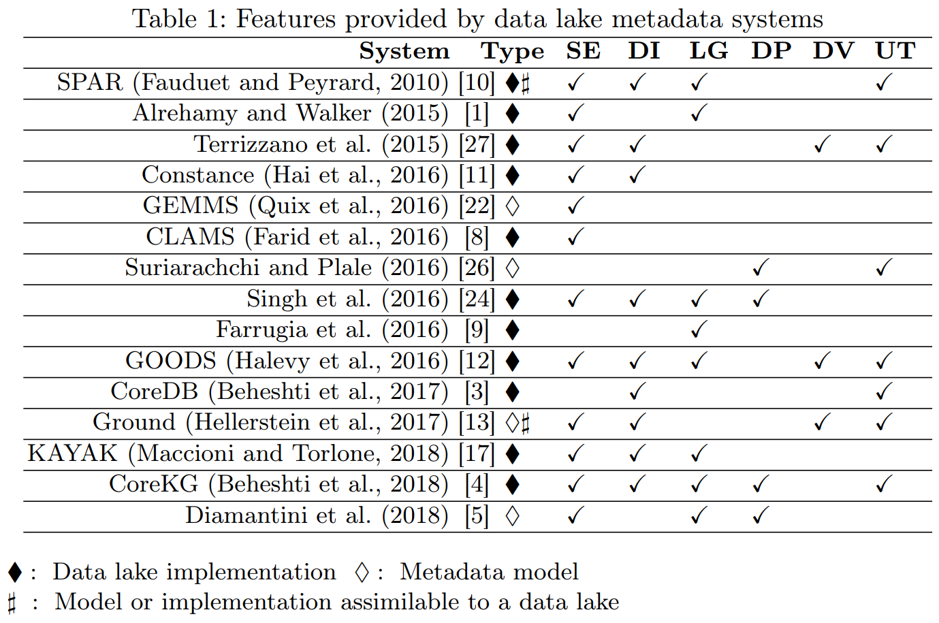
Knowledge representation
Sawadogo, P. N., Scholly, E., Favre, C., Ferey, E., Loudcher, S., & Darmont, J. (2019, September). Metadata systems for data lakes: models and features. In European conference on advances in databases and information systems (pp. 440-451). Springer, Cham.

Slide 169
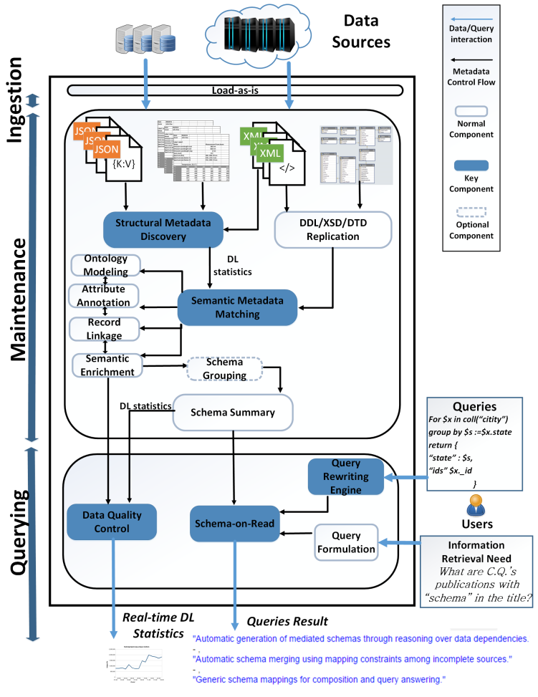
Knowledge representation
Knowledge representation
Few details given on metamodel and functionalities.
No metadata collected on operations.
Hai, R., Geisler, S., & Quix, C. (2016, June). Constance: An intelligent data lake system. In Proceedings of the 2016 international conference on management of data (pp. 2097-2100).

Slide 170
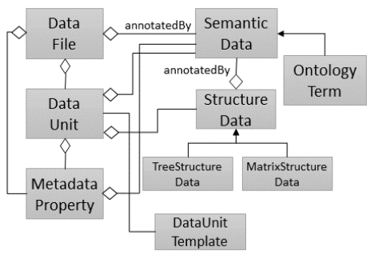
Knowledge representation
Knowledge representation
No discussion about the functionalities provided.
No metadata collected on operations and agents.
Quix, C., Hai, R., & Vatov, I. (2016). GEMMS: A Generic and Extensible Metadata Management System for Data Lakes. In CAiSE forum (Vol. 129).

Slide 171
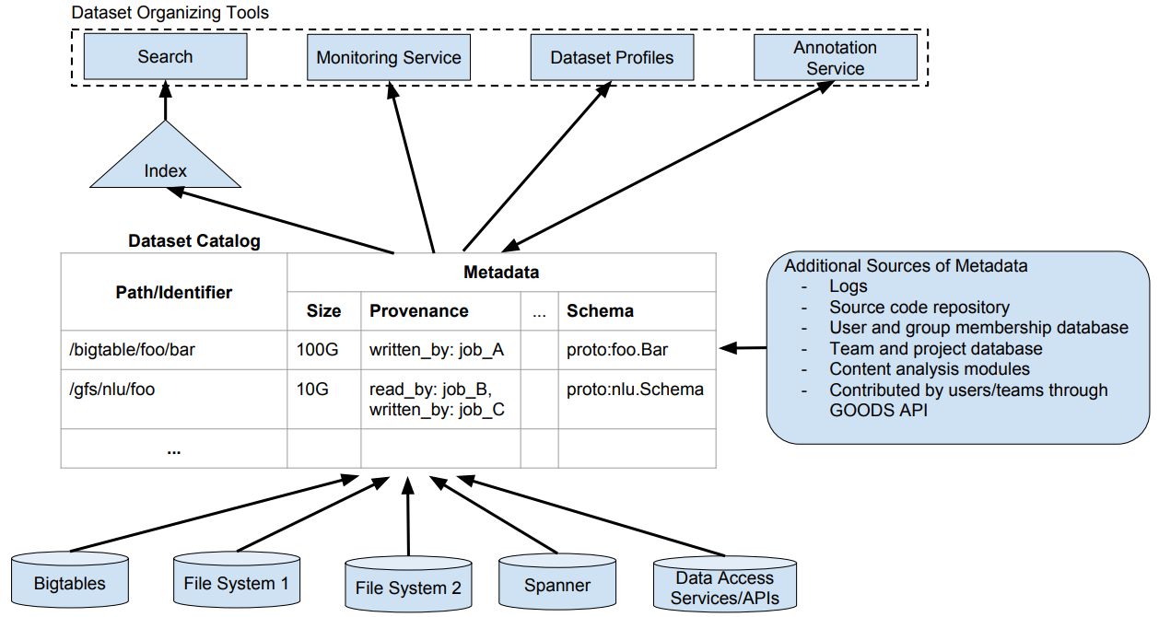
Knowledge representation
Knowledge representation
Crawls Google’s storage systems to extract basic metadata on datasets and their relationship with other datasets.
Performs metadata inference, e.g., to determine the schema of a non-self-describing dataset, to trace the provenance of data through a sequence of processing services, or to annotate data with their semantics.
Strictly coupled with the Google platform.
Mainly focuses on object description and searches.
No formal description of the metamodel.
Halevy, A. Y., Korn, F., Noy, N. F., Olston, C., Polyzotis, N., Roy, S., & Whang, S. E. (2016). Managing Google's data lake: an overview of the Goods system. IEEE Data Eng. Bull., 39(3), 5-14.

Slide 172
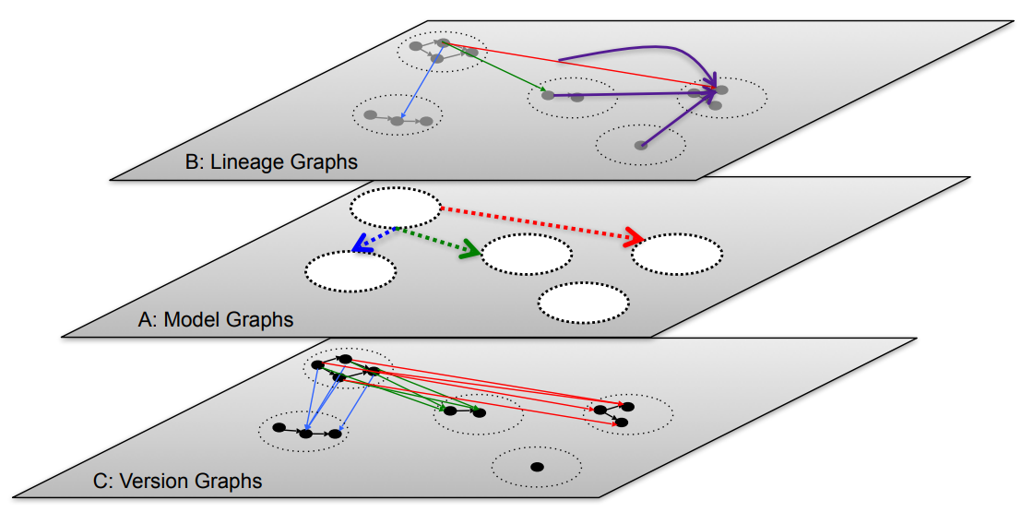
Knowledge representation
Knowledge representation
Version graphs represent data versions.
Model graphs represent application metadata, i.e., how data are interpreted for use.
Lineage graphs capture usage information.
Not enough details given to clarify which metadata are actually handled.
Functionalities are described at a high level.
Hellerstein, J. M., Sreekanti, V., Gonzalez, J. E., Dalton, J., Dey, A., Nag, S., ... & Sun, E. (2017, January). Ground: A Data Context Service. In CIDR.

Slide 173
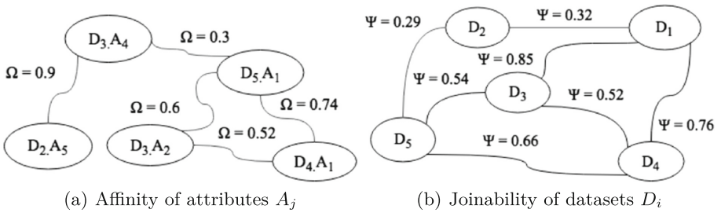

Knowledge representation
Knowledge representation
Support users in creating and optimizing the data processing pipelines.
Only goal-related metadata are collected.
Maccioni, A., & Torlone, R. (2018, June). KAYAK: a framework for just-in-time data preparation in a data lake. In International Conference on Advanced Information Systems Engineering (pp. 474-489). Springer, Cham.

Slide 174

Knowledge representation
Knowledge representation
Technical
Operational
Business
Francia, M., Francia, E., Golfarelli, M., Leoni, A. G., Rizzi, S., & Santolini, N. (2021). Making data platforms smarter with MOSES. Future Generation Computer Systems, 125, 299-313.

Slide 175

Knowledge representation
Knowledge representation
Francia, M., Francia, E., Golfarelli, M., Leoni, A. G., Rizzi, S., & Santolini, N. (2021). Making data platforms smarter with MOSES. Future Generation Computer Systems, 125, 299-313.

Slide 176
Knowledge representation
Knowledge representation
Not pre-defined
Domain-independent,
extensible
Francia, M., Francia, E., Golfarelli, M., Leoni, A. G., Rizzi, S., & Santolini, N. (2021). Making data platforms smarter with MOSES. Future Generation Computer Systems, 125, 299-313.

Slide 177
Knowledge representation
Knowledge representation
Tune the trade-off between the level of detail of the functionalities and the required computational effort
Francia, M., Francia, E., Golfarelli, M., Leoni, A. G., Rizzi, S., & Santolini, N. (2021). Making data platforms smarter with MOSES. Future Generation Computer Systems, 125, 299-313.

Slide 178
Knowledge representation
Knowledge representation
Functionalities
Semantic enrichment
Data indexing
Link generation
Data polymorphism
Data versioning
Usage tracking
Francia, M., Francia, E., Golfarelli, M., Leoni, A. G., Rizzi, S., & Santolini, N. (2021). Making data platforms smarter with MOSES. Future Generation Computer Systems, 125, 299-313.

Slide 179
Example of data platform: MOSES
Example of a data platform (MOSES)
Functional architecture
Components of MOSES are in orange
Others are standard components in charge of producing/consuming, processing, storing, and visualizing data
The orchestrator (e.g., Oozie) manages (e.g., schedules) the data transformation processes
Orchestrator
Data Processes
MOSES
Proc. 1
Proc. 2
…
Proc. m
Metadata Extractor
Metadata Search
Engine
Provenance Manager
Storage
Trigger Engine
Other Storages
DFS
Custom components
Metadata
Process Interfaces
MOSES Interfaces
Web Interface
Other Interfaces
Workflow Administration
Metadata GUI
Francia, M., Gallinucci, E., Golfarelli, M., Rizzi, S. et al. (2021). Making data platforms smarter with MOSES. Future Generation Computer Systems, 125, 299-313.

Slide 180
Capturing the metadata
Knowledge exploitation
Pull strategy
The system actively collects new metadata
Requires scheduling: when does the system activate itself?
Event-based (CRUD)
Time-based
Requires wrappers: what does the system capture?
Based on data type and/or application
A comprehensive monitoring is practically unfeasible
Push strategy
The system passively receives new metadata
Requires an API layer
Mandatory for operational metadata

Slide 181
Knowledge representation
Knowledge representation
A classification of functionalities enabled by metadata
Semantic enrichment
Generating a description of the context of data, e.g., with tags, to make them more interpretable and understandable
Data indexing
Data structures to retrieve datasets based on specific characteristics (keywords or patterns)
Link generation and conservation
Detecting similarity relationships or integrating preexisting links between datasets
Data polymorphism
Storing multiple representations of the same data to avoid repeating pre-processings and speed up analyses
Data versioning
Support data changes while conserving previous states
Usage tracking
Records the interactions between users and the data
Sawadogo, P. N., Scholly, E., Favre, C., Ferey, E., Loudcher, S., & Darmont, J. (2019, September). Metadata systems for data lakes: models and features. In European conference on advances in databases and information systems (pp. 440-451). Springer, Cham.

Slide 182
Managing data platforms
Data provenance
Compression
Data profiling
Entity resolution
Data versioning
…

Slide 183

Data profiling
Data profiling
A broad range of methods to efficiently analyze a given data set
E.g., in a relational scenario, tables of a relational database are scanned to derive metadata, such as data types and value patterns, completeness and uniqueness of columns, keys and foreign keys, and occasionally functional dependencies and association rules
Naumann, Felix. "Data profiling revisited." ACM SIGMOD Record 42.4 (2014): 40-49.

Slide 184
Data profiling
Use cases
Query optimization
Performed by DBMS to support query optimization with statistics about tables and columns
Profiling results can be used to estimate the selectivity of operators and the cost of a query plan
Data cleansing (typical use case is profiling data)
Prepare a cleansing process by revealing errors (e.g., in formatting), missing values or outliers
Data integration and analytics
Challenges?
Naumann, Felix. "Data profiling revisited." ACM SIGMOD Record 42.4 (2014): 40-49.

Slide 185

Data profiling
a | b | c | d
1 | 1 | 2 | 2
1 | 2 | 1 | 4
Challenges
The results of data profiling are computationally complex to discover
E.g., discovering keys/dependencies usually involves some sorting step for each considered column
Verification of complex constraints on column combinations in a database
What is the complexity of this task?
Complexity
Given a table with columns C = { a, b, c, d }
To extract the (distinct) cardinality of each column, I will consider |C| columns
(a), (b), (c), (d)
To extract the correlations between pairs of columns, I will consider $\left({|C| \atop 2}\right)$ groups
(a, b), (a, c), (a, d), (b, c), (c, d), (c, d)
Extracting the relationships among all possible groups of columns generalizes to $\sum_{n=1}^{|C|}{\left({|C| \atop n}\right)}=2^{|C|}−1$ groups
Naumann, Felix. "Data profiling revisited." ACM SIGMOD Record 42.4 (2014): 40-49.

Slide 186
Object profiling and search
Knowledge exploitation
Discoverability is a key requirement for data platforms
Simple searches to let users locate “known” information
Data exploration to let users uncover “unknown” information
Common goal: identification and description of Objects
Two levels of querying
Metadata level (most important)
Data level (can be coupled with the first one)

Slide 187
Object profiling and search
Knowledge exploitation
Basic search
MATCH (o:Object)-[]-(:Project {name:"ABC"}) RETURN o
Return all objects of a given project
MATCH (o:Object)-[]-(d:DataLakeArea) WHERE d.name = "Landing" AND o.name LIKE "2021_%" AND o.size < 100.000 RETURN o
Return small objects with a given name pattern in the landing area
Notes:
100000 kb = 100 mb

Slide 188
Object profiling and search
Knowledge exploitation
Schema-driven search
MATCH (o:Object)-[]-(:Schema)-[]-(a:Attribute), (a)-[]-(:Domain {name: "FiscalCode"}) RETURN o
Return objects that contain information referring to a given Domain
Notes:
100000 kb = 100 mb

Slide 189
Object profiling and search
Knowledge exploitation
Provenance-driven search
MATCH (obj1:Object)-[:readsFrom]-(o:Operation)-[:writesTo]-(obj2:Object) CREATE (obj1)-[:ancestorOf]->(obj2)
MATCH (:Object {id:123})-[:ancestorOf*]-(obj:Object) RETURN obj
Discover objects obtained from a given ancestor
MATCH (obj:Object)-[:ancestorOf*]-(:Object {id:123}) RETURN obj
Discover object(s) from which another has originated
Example: a ML team wants to use datasets that were publicized as canonical for certain domains, but they find these datasets being too “groomed” for ML
Provenance links can be used to browse upstream and identify the less-groomed datasets that were used to derive the canonical datasets
Notes:
100000 kb = 100 mb

Slide 190
Object profiling and search
Knowledge exploitation
Similarity-driven search
MATCH (:Object {id:123})-[r:similarTo]-(o:Object) WHERE r.similarityType="affinity" RETURN o
Discover datasets to be merged in a certain query
MATCH (:Object {id:123})-[r:similarTo]-(o:Object) WHERE r.similarityType="joinability" RETURN o
Discover datasets to be joined in a certain query
Group similar objects and enrich the search results
List the main objects from each group
Restrict the search to the objects of a single group
Notes:
100000 kb = 100 mb

Slide 191
Object profiling and search
Knowledge exploitation
Semantics-driven search
MATCH (o:Object)-[:isDescribedBy]-(:OntologyTerm {uri:"http://..."}) RETURN o
MATCH (o:Object)-[*]-(any), (any)-[:isDescribedBy]-(:OntologyTerm {uri:"http://..."}) RETURN o
Search objects without having any knowledge of their physical or intensional properties, but simply exploiting their traceability to a certain semantic concept
Notes:
100000 kb = 100 mb

Slide 192
Object profiling and search
Knowledge exploitation
Profiling
MATCH (o:Object)-[]-(:OntologyType {name:"Table"}), (o)-[]-(s:Schema)-[]-(a:Attribute), (o)-[r:similarTo]-(o2:Object), (o)-[:ancestorOf]-(o3:Object), (o4:Object)-[:ancestorOf]-(o) RETURN o, s, a, r, o2, o3, o4
Shows an object’s properties, list the relationships with other objects in terms of similarity and provenance
Compute a representation of the intensional features that mostly characterize a group of objects (see slides on schema heterogeneity)
Notes:
100000 kb = 100 mb

Slide 193
Provenance and versioning
Knowledge exploitation
Provenance: metadata pertaining to the history of a data item
Any information that describes the production process of an end product
Encompasses meta-data about entities, data, processes, activities, and persons involved in the production process
Essentially, it describes a transformation pipeline, including the origin of objects and the operations they are subject to
J.Wang, D. Crawl, S. Purawat, M. H. Nguyen, I. Altintas, Big data provenance: Challenges, state of the art and opportunities, in: Proc. BigData, Santa Clara, CA, USA, 2015, pp. 2509–2516.
M. Herschel, R. Diestelk¨amper, H. Ben Lahmar, A survey on provenance: What for? What form? What from?, VLDB J. 26 (6) (2017) 881–906.
Notes:
100000 kb = 100 mb

Slide 194
Data provenance
Provenance (also referred to as lineage, pedigree, parentage, genealogy)
The description of the origins of data and the process by which it arrived at the database
Not only data products (e.g., tables, files), but also the processes that created them
Use cases
Business domain. Users traditionally work with an organized data schema, where the structure and semantics of the data in use is shared across the corporation or even B2B. Yet, a large proportion of businesses deal with bad quality data. Sources of bad data need to be identified and corrected to avoid costly errors in business forecasting.
Scientific/research domain. Data used in the scientific field can be ad hoc and driven by individual researchers or small communities. The scientific field is moving towards more collaborative research and organizational boundaries are disappearing. Sharing data and metadata across organizations is essential, leading to a convergence on common schemes to ensure compatibility. Issues of trust, quality, and copyright of data are significant when using third-party data in such a loosely connected network.
Simmhan, Yogesh L., Beth Plale, and Dennis Gannon. "A survey of data provenance techniques." Computer Science Department, Indiana University, Bloomington IN 47405 (2005): 69.

Slide 195

Data provenance
Astronomers are creating an international Virtual Observatory
A federation of all the world significant astronomical data resources coupled with provision of the computational resources needed to exploit the data scientifically
Astronomy changed from being an individualistic to a collective enterprise
Telescope time is devoted/allocated to systematic sky surveys and analysis is performed using data from the archives
Astronomers are increasingly relying on data that they did not take themselves
Raw data bear many instrumental signatures that must be removed in the process of generating data products
Mann, Bob. "Some data derivation and provenance issues in astronomy." Workshop on Data Derivation and Provenance, Chicago. 2002. https://www.esa.int/Science_Exploration/Space_Science/Webb/Webb_inspects_the_heart_of_the_Phantom_Galaxy (accessed 2022-08-01)

Slide 196

Data provenance
Simmhan, Yogesh L., Beth Plale, and Dennis Gannon. "A survey of data provenance techniques." Computer Science Department, Indiana University, Bloomington IN 47405 (2005): 69.

Slide 197
Data provenance
Granularity
Fine-grained (instance level): tracking data items (e.g., a tuple in a dataset) transformations
Coarse-grained (schema-level): tracking dataset transformations
Queries
Where provenance: given some output, which inputs did the output come from?
How provenance: given some output, how were the inputs manipulated?
Why provenance: given some output, why was data generated?
E.g., in the form of a proof tree that locates source data items contributing to its creation
Simmhan, Yogesh L., Beth Plale, and Dennis Gannon. "A survey of data provenance techniques." Computer Science Department, Indiana University, Bloomington IN 47405 (2005): 69. Ikeda, Robert, and Jennifer Widom. Data lineage: A survey. Stanford InfoLab, 2009.

Slide 198

Data provenance
Data provenance, an example of data management
Metadata pertaining to the history of a data item
Pipeline including the origin of objects and operations they are subjected to
We have a standard: https://www.w3.org/TR/prov-dm/
https://www.w3.org/TR/prov-dm/

Slide 199

Data provenance
Entity
Physical/conceptual things
Activity
Dynamic aspects of the world, such as actions
How entities come into existence, often making use of previously existing entities
Agent
A person, a piece of software
Takes a role in an activity such that the agent can be assigned some degree of responsibility for the activity taking place
https://www.w3.org/TR/2013/NOTE-prov-primer-20130430/

Slide 200

Provenance and versioning
Knowledge exploitation
PROV: a standard for provenance modeling
Several tools exists for managing PROV metadata
https://openprovenance.org/services/view/translator
https://lucmoreau.github.io/ProvToolbox/
https://prov.readthedocs.io/en/latest/
Compliance with PROV ensures integration with existing tools for querying and visualization
L. Moreau, P. T. Groth, Provenance: An Introduction to PROV, Synthesis Lectures on the Semantic Web: Theory and Technology, Morgan & Claypool Publishers, 2013.
Notes:
https://www.openphactsfoundation.org/wp/wp-content/uploads/2016/05/140609_Cologne_IPAW-2014_Paul-Groth_Provenance.pdf

Slide 201
Data provenance
Use cases for data provenance
Accountability and auditing
Data quality
Monitoring of the quality (e.g., accuracy) of the objects produced
Notify when a transformation pipeline is not behaving as expected
Debugging
Inferring the cause of pipeline failures is challenging
Store inputs of each operation with versions and environmental settings (RAM, CPUs, etc.)
And so on...

Slide 202
Provenance and versioning
Knowledge exploitation
Several use cases
Supply chain
Assess food’s quality and gain trust in food products
Scientific experiments
Experiments on big data scales are not easily repeatable (e.g., 100 PB workloads @CERN, SKA)
Ensuring the reproducibility and accessibility of the scientific results is essential
Complex data processing
The development of complex data processing pipelines is iterative/incremental
Provenance analysis leads to faster and higher-quality analysis, debugging, and refinement
New, S.: The transparent supply chain. Harvard Bus. Rev.88, 1–5(2010)
Cranmer, K., Heinrich, L., Jones, R., South, D.M.: Analysis preservation in ATLAS. J. Physi.664(3) (2015).
Bourhis, P., Deutch, D., Moskovitch, Y.: POLYTICS: provenance-based analytics of data-centric applications. In: IEEE International Conference on Data Engineering (ICDE), pp. 1373–1374(2017)
Notes:
100000 kb = 100 mb

Slide 203

Provenance and versioning
Knowledge exploitation
A taxonomy of provenance techniques
Y. Simmhan, B. Plale, D. Gannon, A survey of data provenance in e-science,SIGMOD Rec. 34 (3) (2005) 31–36.
Notes:
https://dl.acm.org/doi/pdf/10.1145/1084805.1084812
OPPURE https://ieeexplore.ieee.org/document/7364047

Slide 204
Provenance and versioning
Knowledge exploitation
Provenance functionalities (activated by metadata)
Data quality
Monitoring accuracy, precision, and recall of produced objects to notify the data scientist when a transformation pipeline is not behaving as expected
Debugging
Inferring the cause of pipeline failures is challenging and requires an investigation of the overall processing history, including input objects and the environmental settings
Reproducibility
Re-execution of all or part of the operations belonging to a pipeline
Trustworthiness
Help data scientists to trust the objects produced by tracing them back to their sources and storing the agents who operated on those objects
Versioning
Marking a generated object and its versions (e.g., due to changes in a database schema) helps in identifying relevant objects along with their semantic versions, and to operate with legacy objects

Slide 205
Provenance and versioning
Knowledge exploitation
An important aspect is the granularity of provenance
Fine-grained provenance is typically used for single vertical applications
It requires to collect huge amounts of detailed information to enable a very detailed tracing
Coarse-grained provenance is appropriate to ensure a broad coverage of highly heterogeneous transformations possibly involving several applications and datasets
Choosing a granularity is the result of a trade-off between accuracy and computational effort
Storing only the name and the version of a clustering algorithm enables an approximate reproducibility of the results
Storing all its parameters makes this functionality much more accurate

Slide 206
Provenance and versioning
Knowledge exploitation
Some current research directions
Expand PROV to better suite big data scenarios
Y. Gao, X. Chen and X. Du, A Big Data Provenance Model for Data Security Supervision Based on PROV-DM Model, in IEEE Access, vol. 8, pp. 38742-38752, 2020.
Define provenance-based approaches to measure the quality of big data
Taleb, I., Serhani, M.A., Bouhaddioui, C. et al. Big data quality framework: a holistic approach to continuous quality management. J Big Data 8, 76 (2021).
An outline of the challenges, including granularity identification, integration, security concerns
A. Chacko and S. D. Madhu Kumar, Big data provenance research directions, TENCON 2017 - 2017 IEEE Region 10 Conference, 2017, pp. 651-656, doi: 10.1109/TENCON.2017.8227942.
Blockchain-based provenance systems
Dang, T. K., & Duong, T. A. (2021). An effective and elastic blockchain-based provenance preserving solution for the open data. International Journal of Web Information Systems.
Ruan, P., Dinh, T. T. A., Lin, Q., Zhang, M., Chen, G., & Ooi, B. C. (2021). LineageChain: a fine-grained, secure and efficient data provenance system for blockchains. The VLDB Journal, 30(1), 3-24.

Slide 207
Orchestration support
Knowledge exploitation
The orchestrator is the component in charge of controlling the execution of computation activities
Either through a regular scheduling of the activities
Or by triggering a process in response to a certain event
Several entities (either processes or human beings) can cover this role to activate some data processes
Notes:
100000 kb = 100 mb

Slide 208
Orchestration support
Knowledge exploitation
Orchestration functionalities (activated by metadata)
Dynamic/condition-based behavior
Decide what data process should be activated under different conditions
Decide how to tune the parameters in case of parametric data processes
Triggering
Decide when to trigger a certain data process
Scoping
Assess the trustworthiness of objects to decide if a certain data process should be activated or not
Resource estimation/prediction
Decide the optimal amount of resources required to terminate successfully while leaving sufficient resources to the other concurrent process, based on previous executions and current settings
Negotiate the resources with the cluster’s resource manager
Notes:
100000 kb = 100 mb

Slide 209

Orchestration support
Knowledge exploitation
Orchestration requirements & challenges
Barika, M., Garg, S., Zomaya, A. Y., Wang, L., Moorsel, A. V., & Ranjan, R. (2019). Orchestrating big data analysis workflows in the cloud: research challenges, survey, and future directions. ACM Computing Surveys (CSUR), 52(5), 1-41.
Notes:
100000 kb = 100 mb

Slide 210
Orchestration support
Knowledge exploitation
Orchestration requirements
R1 Compute/CPU resource provisioning
Determine the right amount of resources
Continuously monitor and manage them in a dynamic execution environment
R2 Storage
Choose the right cloud storage resource, data location, and format (if the application is parametric)
R3 Data movement
Dynamically transfer large datasets between compute and storage resources
R4 Synchronization and asynchronization
Manage the control and data flow dependencies across analytics tasks
Barika, M., Garg, S., Zomaya, A. Y., Wang, L., Moorsel, A. V., & Ranjan, R. (2019). Orchestrating big data analysis workflows in the cloud: research challenges, survey, and future directions. ACM Computing Surveys (CSUR), 52(5), 1-41.
Notes:
100000 kb = 100 mb

Slide 211
Orchestration support
Knowledge exploitation
Orchestration requirements
R5 Analytic task scheduling and execution
Scheduling and coordinating the execution of workflow tasks across diverse sets of big data programming models
Tracking and capturing provenance of data
R6 Service Level Agreement
Executions may need to meet user-defined QoS requirements (e.g., a strict execution deadline)
R7 Security
Beyond standard encryption approaches: private (anonymous) computation, verification of outcomes in multi-party settings, placement of components according to security policies
R8 Monitoring and Failure-Tolerance
Ensure that everything is streamlined and executed as anticipated
As failures could happen at any time, handle those failures when they occur or predicting them before they happen
Barika, M., Garg, S., Zomaya, A. Y., Wang, L., Moorsel, A. V., & Ranjan, R. (2019). Orchestrating big data analysis workflows in the cloud: research challenges, survey, and future directions. ACM Computing Surveys (CSUR), 52(5), 1-41.
Notes:
100000 kb = 100 mb

Slide 212
Orchestration support
Knowledge exploitation
Orchestration challenges
Cloud Platform Heterogeneity
Integration (different APIs, virtualization formats, pricing policies, hardware/software configurations)
Workflow Migration (e.g., to aspire to specific QoS features in the target cloud or better price)
Cloud Resource Management
Resource Provisioning (selecting the right configuration of virtual resources; the resource configuration search space grows exponentially, and the problem is often NP-complete)
Resource-based Big Data Programming Frameworks Management (automatically select the configurations for both IaaS-level resource and PaaS-level framework to consistently accomplish the anticipated workflow-level SLA requirements, while maximizing the utilization of cloud datacenter resources)
Resource Volatility (at different levels: VM-level, big data progressing framework-level and workflow task-level)
Barika, M., Garg, S., Zomaya, A. Y., Wang, L., Moorsel, A. V., & Ranjan, R. (2019). Orchestrating big data analysis workflows in the cloud: research challenges, survey, and future directions. ACM Computing Surveys (CSUR), 52(5), 1-41.
Notes:
100000 kb = 100 mb

Slide 213
Orchestration support
Knowledge exploitation
Orchestration challenges
Data-related
Storage (where the data will be residing, which data format will be used)
Movement (minimize transfer rates, exploit data locality in task-centric or worker-centric way)
Provenance (trade-off expressiveness with overhead)
Indexing (which dataset is worth indexing and how)
Security and Privacy (cryptography, access control, integrity, masking, etc.)
Barika, M., Garg, S., Zomaya, A. Y., Wang, L., Moorsel, A. V., & Ranjan, R. (2019). Orchestrating big data analysis workflows in the cloud: research challenges, survey, and future directions. ACM Computing Surveys (CSUR), 52(5), 1-41.

Slide 214
Orchestration support
Knowledge exploitation
Orchestration challenges
Workflow-related
Specification Language (devising a high level, technology-/cloud-independent workflow language)
Initialization (subdivision into fragments considering dependencies, constraints, etc.)
Parallelization and Scheduling (with super-workflows defined at application and task level)
Fault-Tolerance (thing can go wrong at workflow-, application-, and cloud-level)
Security (securing workflow logic and computation)
Barika, M., Garg, S., Zomaya, A. Y., Wang, L., Moorsel, A. V., & Ranjan, R. (2019). Orchestrating big data analysis workflows in the cloud: research challenges, survey, and future directions. ACM Computing Surveys (CSUR), 52(5), 1-41.
Notes:
100000 kb = 100 mb

Slide 215

Compression
Summarization / compression
Present a concise representation of a dataset in a comprehensible and informative manner
Ahmed, Mohiuddin. "Data summarization: a survey." Knowledge and Information Systems 58.2 (2019): 249-273.

Slide 216

Entity resolution
Entity resolution
(also known as entity matching, linking)
Find records that refer to the same entity across different data sources (e.g., data files, books, websites, and databases)
Papadakis, George, et al. "Blocking and filtering techniques for entity resolution: A survey." ACM Computing Surveys (CSUR) 53.2 (2020): 1-42.

Slide 217

Data versioning
Version control
A class of systems responsible for managing changes to computer programs, documents, or data collections
Changes are identified by a number/letter code, termed the revision/version number
However, data pipelines are not only about code bult also about
Model Version control
Data Version Control
Model Parameter Tracking
Model Performance Comparison

Slide 218



Data versioning
Support CRUD (Create, Read, Update, Delete) operations with versions
E.g., on AWS (PUT, GET, DELETE), what about update?
https://docs.aws.amazon.com/AmazonS3/latest/userguide/versioning-workflows.html (accessed 2022-08-01)

Slide 219

In action
Lab: California housing prices

Slide 220
Data platform
Are we done? No!
Metadata can become bigger than data themselves
We need meta meta-data (or models)...
... chasing our own tails
Data management is still a (research) issue in data platforms

Slide 221
Summing up
Storage should be flexible enough to support heterogenous data models and raw data
From operational databases to DWHs (why?)
From relational data models to NoSQL (why?)
Data lake to (directly) ingest raw data
Storage, per se, is insufficient to get value from the data (examples?)
We also need data processing and fruition
Data lakes are blurring into data platforms
Data platforms support end-to-end data needs (which ones?)
Building data platforms is hard (why?)
Managing data platforms is hard, exploit meta-data to ease this task
Data lineage, compression, profiling, resolution, etc.
Open question: how do we deploy working data platforms?

Slide 222
Polyglot persistence
Polyglot persistence
To each application the appropriate DBMS
Notes:
A key-value data store could be used to store the shopping cart data before the order is confirmed by the customer and also store the session data so that the RDBMS is not used for this transient data. Key-value stores make sense here since the shopping cart is usually accessed by user ID and, once confirmed and paid by the customer, can be saved in the RDBMS. Similarly, session data is keyed by the session ID. If we need to recommend products to customers when they place products into their shopping carts—for example, “ your friends also bought these products” or “ your friends bought these accessories for this product”—then introducing a graph data store in the mix becomes relevant.
Even using specialized relational databases for different purposes, such as data warehousing appliances or analytics appliances within the same application, can be viewed as polyglot persistence

Slide 223
Polyglot persistence
Polyglot persistence
To each application the appropriate DBMS - works well for OLTP
What about OLAP?
OLAP application
Notes:
A key-value data store could be used to store the shopping cart data before the order is confirmed by the customer and also store the session data so that the RDBMS is not used for this transient data. Key-value stores make sense here since the shopping cart is usually accessed by user ID and, once confirmed and paid by the customer, can be saved in the RDBMS. Similarly, session data is keyed by the session ID. If we need to recommend products to customers when they place products into their shopping carts—for example, “ your friends also bought these products” or “ your friends bought these accessories for this product”—then introducing a graph data store in the mix becomes relevant.
Even using specialized relational databases for different purposes, such as data warehousing appliances or analytics appliances within the same application, can be viewed as polyglot persistence

Slide 224
Polyglot persistence: main challenges
Data model heterogeneity
Support multiple models in the same database
Or integrate data from different databases using different query languages
Schema heterogeneity
Inter-collection: different records in different collections have different schemas
Not a new problem: think federated databases, corporate mergers, etc.
Intra-collection: different records in the same collection have different schemas
Emerged with NoSQL databases
Data inconsistency
Reconcile inconsistent versions of the same data (inter- or intra-collection)
Notes:
Data model heterogeneity is a problem for OLAP
Schema het is a problem for OLAP
Data inc is a problem for OLAP

Slide 225





Data model heterogeneity

Slide 226
Basic solutions
DM heterogeneity
Some DBMSs offer multi-model support
Extended RDBMSs
KV implementable as a table with two fields: a string key, and a blob value
Cypher query language on top of a relational implementation of a graph
Hstore data type in PostgreSQL for wide-column-like implementation
Scalabilty issue remains
Multi-model NoSQL DBMSs
ArangoDB, OrientDB
Support all NoSQL data models, but not the relational one
Some approaches suggest strategies to model everything within RDBMSs
DiScala, M., Abadi, D.J.: Automatic generation of normalized relational schemas from nested key-value data. In: 2016 ACM SIGMOD Int. Conf. on Management of Data, pp. 295-310. ACM (2016)
Tahara, D., Diamond, T., Abadi, D.J.: Sinew: a SQL system for multi-structured data. In: 2014 ACM SIGMOD Int. Conf. on Management of Data, pp. 815-826. ACM (2014)

Slide 227
A taxonomy for distributed solutions
DM heterogeneity
Federated database system
Homogeneous data stores, exposes a single standard query interface
Features a mediator-wrapper architecture, employs schema-mapping and entity-merging techniques for integration of relational data
Polyglot system
Homogeneous data stores, exposes multiple query interfaces
Takes advantage of the semantic expressiveness of multiple interfaces (e.g., declarative, procedural)
Multistore system
Heterogeneous data stores, exposes a single query interface
Provides a unified querying layer by adopting ontologies and applying schema-mapping and entity-resolution techniques
Polystore system
Heterogeneous data stores, exposes multiple query interfaces
Choose from a variety of query interfaces to seamlessly query data residing in multiple data stores
R. Tan, R. Chirkova, V. Gadepally and T. G. Mattson, "Enabling query processing across heterogeneous data models: A survey," 2017 IEEE International Conference on Big Data (Big Data), 2017, pp. 3211-3220.

Slide 228

Advanced solutions
DM heterogeneity
Example of a polystore
Island = a middleware application to support a set of operations on a given data model
Shim = a wrapper to convert from the island’s query language to the target DB’s query language
Vijay Gadepally, Kyle O'Brien, Adam Dziedzic, Aaron J. Elmore, Jeremy Kepner, Samuel Madden, Tim Mattson, Jennie Rogers, Zuohao She, Michael Stonebraker: Version 0.1 of the BigDAWG Polystore System. CoRR abs/1707.00721 (2017)

Slide 229
Advanced solutions
DM heterogeneity
Most notable multistore/polystore proposals
BigDAWG
Focus on the ability to “move” data from one DB to another to improve query efficiency
V. Gadepally et al. Version 0.1 of the BigDAWG Polystore System. CoRR abs/1707.00721 (2017)
Estocada
Focus on taking advantage of possible (consistent) redundancy and previous query results
R. Alotaibi et al. ESTOCADA: Towards Scalable Polystore Systems. Proc. VLDB Endow. 13(12): 2949-2952 (2020)
Awesome
Focus on supporting common analytical functions
S. Dasgupta. Analytics-driven data ingestion and derivation in the AWESOME polystore. IEEE BigData 2016: 2555-2564
CloudMdsQL
Focus on taking advantage of local data store native functionalities
B. Kolev et al. CloudMdsQL: querying heterogeneous cloud data stores with a common language. Distributed Parallel Databases 34(4): 463-503 (2016)

Slide 230
Beyond data model heterogeneity
What else is there?
Entity resolution
Every approach needs some kind of integrated knowledge
Ample research from federated database systems
Usually “out-of-scope”
Management of schema heterogeneity and data inconsistency
Usually addressed as different problems in the literature

Slide 231
Schema heterogeneity
Heterogeneous data stored with variant schemata and structural forms
Missing/additional attributes
Different names/types of attributes
Different nested structures
Two main problems
Understand the data
Query the data

Slide 232
Understanding the data
Schema heterogeneity
Early work on XML
To deal with the widespread lack of DTDs and XSDs
Extract regular expressions to described the content of elements in a set of XML documents
Recent work on JSON
Concise view: a single representation for all schema variations
Union of all attributes
M. Klettke et al. Schema extraction and structural outlier detection for JSON-based NoSQL data stores., in: Proc. BTW, volume 2105, 2015, pp. 425-444.
A skeleton as the smallest set of core attributes according to a frequency-based formula
L. Wang et al. Schema management for document stores, Proc. VLDB Endowment 8 (2015) 922-933.
Comprehensive view: multiple representations (a different schema for every document)
D. S. Ruiz, et al. Inferring versioned schemas from NoSQL databases and its applications, in: Proc. ER, 2015, pp. 467-480.
Schema profile: explain why there are different schemas
Matteo Francia et al. Schema profiling of document-oriented databases. Inf. Syst. 75: 13-25 (2018)

Slide 233
Schema profiling
Schema heterogeneity
Schema profiles explain
What are the differences between schemas
When/why is one schema used instead of the other
The problem of schema profiling is quite similar to a classification problem
Classifiers are also used to describe the rules for assigning a class to an observation based on the other observation features
Based on the requirements collected from potential users, decision trees emerged as the most adequate
SchemaID | User | Activity | Weight | Duration | Repetitions
S1 | Jack | Run |  | 108
S2 | John | Leg press | 80 | 4 | 23
S1 | Kate | Walk |  | 42
S3 | John | Push-ups |  | 8 | 40
Documents / Observations
Schema / Class

Slide 234

Schema profiling
Schema heterogeneity
The documents are the observations
The schemata are the classes

Slide 235
Schema profiling
Schema heterogeneity
Value-based condition

Slide 236
Schema profiling
Schema heterogeneity
Value-based condition
Schema-based condition

Slide 237
Schema profiling
Schema heterogeneity
Value-based condition
Schema-based condition

Slide 238
Preliminary activities
Schema heterogeneity
Semi-structured interviews with 5 users
Application domains: fitness equipment sales, software development
Understand goals, requirements, visualization format
Not one complete/correct dataset description
Definition of schema profile characteristics
Explicativeness
Precision
Conciseness

Slide 239
Explicativeness
Schema heterogeneity
Value-based (VB) conditions are preferred to schema-based (SB) ones
SB: acknowledge a difference between schemata
VB: explain it in terms of the values taken by an attribute
The less SB conditions, the more explicativeness

Slide 240

Precision
Schema heterogeneity
A decision tree is precise if all the leaves are pure
A leaf is pure if all its observations belong to the same class
Leaf v_{j} is pure if entropy(v_{j}) = 0
Entropy is strictly related to precision
Divisive approaches typically stop only when the leaves are all pure
probability of schema s within leaf v_{j}
Pure
Almost
pure
Not
pure
Pure

Slide 241
Precision and conciseness
Schema heterogeneity
Minimization of entropy often leads to splitting observations of the same class among several leaves
Entropy's sole focus is on node purity
More frequent when the number of classes is high
Typically, precision is more important than readability
In schema profiling, this is a critical problem
It conflicts with the conciseness requirement
Notes:
In generic classification problems

Slide 242

Conciseness
Schema heterogeneity
A maximally concise schema profile is one where there is a single rule for each schema
Schema entropy: inverts the original definition of entropy, relating it to the purity of the schemata instead of the purity of the leaves
Entropy: a leaf is pure if it contains only documents with the same class
Schema entropy: a schema is pure if all its documents are in the same leaf
Notes:
In generic classification problems

Slide 243
Conciseness
Schema heterogeneity
A maximally concise schema profile is one where there is a single rule for each schema
Schema entropy: inverts the original definition of entropy, relating it to the purity of the schemata instead of the purity of the leaves
Entropy: a leaf is pure if it contains only documents with the same class
Schema entropy: a schema is pure if all its documents are in the same leaf
Pure
Not pure
Pure
Pure
Notes:
In generic classification problems

Slide 244
Schema profiling example
Schema heterogeneity
 | v₁ |  |  | v₁ | v₂ | v₃ | v₄
s₁ | 40 |  | s₁ | 40
s₂ | 30 |  | s₂ |  | 30
s₃ | 20 |  | s₃ |  |  | 20
s₄ | 10 |  | s₄ |  |  |  | 10
Starting situation
E = 1,85 (maximum)
SE = 0 (minimum)
Best outcome
E = 0
SE = 0
 | v₁ | v₂ |  |  | v₁ | v₂ | v₃
s₁ | 40 |  |  | s₁ | 40
s₂ | 30 |  |  | s₂ |  | 30
s₃ | 20 |  |  | s₃ |  |  | 20
s₄ |  | 10 |  | s₄ | 4 | 3 | 3
E = 1,38
SE = 0
E = 0,46
SE = 0,16

Slide 245

Schema profiling algorithm
Schema heterogeneity
Introduced the notion of schema entropy loss
Defined a criterion for comparing two splits in the decision tree

Slide 246
Querying the data
Schema heterogeneity
One thing is understanding the data, another thing is enabling querying over heterogeneous data
What we need
Integration techniques to solve schema heterogeneity and produce a global knowledge
Query rewriting techniques to translate queries on the global knowledge to queries on the actual schemas
(Focus on OLAP queries)

Slide 247

Integration techniques
Schema heterogeneity
Integration at the intensional level
Schema matching and mapping
A match is a correspondence between attributes
A mapping is a function to explain the relationship between attributes
E.g., S1.FullName = CONCAT(S2.FirstName, S2.LastName)
Integration at the extensional level
Entity resolution (a.k.a. record linkage or duplicate detection)
Identifying (or linking, or grouping) different records referring to the same real-world entity
Aims at removing redundancy and increasing conciseness
Data fusion
Fuse records on the same real-world entity into a single record and resolve possible conflicts
Aims at increasing correctness of data
E. Rahm, P.A. Bernstein, A survey of approaches to automatic schema matching, VLDB J. 10 (4) (2001)
Mandreoli, F., & Montangero, M. (2019). Dealing with data heterogeneity in a data fusion perspective: models, methodologies, and algorithms. In Data Handling in Science and Technology (Vol. 31, pp. 235-270). Elsevier.

Slide 248


OLAP querying
Schema heterogeneity
A first approach to OLAP on heterogeneous data
Francia, E., Golfarelli, M., & Rizzi, S. (2019). Approximate OLAP of document-oriented databases: A variety-aware approach. Information Systems, 85, 114-130.

Slide 249
OLAP querying
Schema heterogeneity
Some limitations
Expensive querying
Does not scale well with the number of schemas
Expensive integration
High levels of heterogeneity imply complex rewriting rules (requiring knowledge and time)
Assuming to be always able to obtain a global schema is a bit pretentious

Slide 250

OLAP querying
Schema heterogeneity
Some limitations
Expensive querying
Does not scale well with the number of schemas
Expensive integration
High levels of heterogeneity imply complex rewriting rules (requiring knowledge and time)
Assuming to be always able to obtain a global schema is a bit pretentious
“One does not simply define a global schema”

Slide 251
New integration techniques
Schema heterogeneity
Replace the global schema with a dataspace
A dataspace is a lightweight integration approach providing basic query expressive power on a variety of data sources, bypassing the complexity of traditional integration approaches and possibly returning best-effort or approximate answers
Franklin, M., Halevy, A., & Maier, D. (2005). From databases to dataspaces: a new abstraction for information management. ACM Sigmod Record, 34(4), 27-33.
Replace traditional integration with a pay-as-you-go approach
The system incrementally understands and integrates the data over time by asking users to confirm matches as the system runs
Jeffery, S. R., Franklin, M. J., & Halevy, A. Y. (2008, June). Pay-as-you-go user feedback for dataspace systems. In Proceedings of the 2008 ACM SIGMOD international conference on Management of data (pp. 847-860).

Slide 252
New integration techniques
Schema heterogeneity
Introducing new concepts
Features: univocal representation of a group of semantically equivalent attributes
E.g., CustomerName = { S1.name, S2.fullname, S3.customer, S4.cName, … }
Mapping functions must be defined/definable between every couple
Entities: representation of a real-world entity
E.g., customers, products, orders, etc.
The dataspace becomes an abstract view in terms of features and entities

Slide 253


New OLAP querying
Schema heterogeneity
What it looks like
Forresi, C., Gallinucci, E., Golfarelli, M., & Hamadou, H. B. (2021). A dataspace-based framework for OLAP analyses in a high-variety multistore. The VLDB Journal, 30(6), 1017-1040.

Slide 254

New OLAP querying
Schema heterogeneity
Previous issues
Expensive querying
Schema heterogeneity solved at query time
Requires complex - but feasible - algorithms
Expensive integration
Pay-as-you-go approach is quicker, iterative, and more flexible
Dataspace is conceptual, untied to logical data modeling
Now we have a multistore dealing with multiple data models and schema heterogeneity
Forresi, C., Francia, E., Golfarelli, M., & Hamadou, H. B. (2021). A dataspace-based framework for OLAP analyses in a high-variety multistore. The VLDB Journal, 30(6), 1017-1040.

Slide 255
Data inconsitency
Intra-collection
Due to denormalized data modeling
Inter-collection
Due to analytical data offloading
To reduce costs and optimize performance, the historical depth of databases is kept limited
After some years, data are offloaded to cheaper/bigger storages, e.g., cloud storages, data lakes
Offloading implies a change of data model, a change of schema, and obviously an overlapping of instances with the original data
Due to multi-cloud architectures
Enables the exploitation of data spread across different providers and architectures, all the while overcoming data silos through data virtualization
Typical in presence of many company branches
Solutions?
Traditional ETL
Solve inconsistencies on-the-fly

Slide 256

Data fusion
Data inconsistency
Merge operator
Originally introduced as “full outer join merge”
Naumann, F., Freytag, J. C., & Leser, U. (2004). Completeness of integrated information sources. Information Systems, 29(7), 583-615.
Aims to keep as much information as possible when joining the records of two schemas
Avoid any loss of records
Resolve mappings by providing transcoded output
Resolving conflicts whenever necessary

Slide 257
Data fusion
Data inconsistency
Merge operator
Originally introduced as “full outer join merge”
Naumann, F., Freytag, J. C., & Leser, U. (2004). Completeness of integrated information sources. Information Systems, 29(7), 583-615.
Aims to keep as much information as possible when joining the records of two schemas
Avoid any loss of records
Resolve mappings by providing transcoded output
Resolving conflicts whenever necessary
Data fusion
Entity linking
Schema
matching

Slide 258

Data fusion
Data inconsistency
Merge operator

Slide 259

On-the-fly data fusion
Data inconsistency
Merge operator in a query plan
Take the data from heterogeneous sources (in different colors)
Extract records of the single entites (e.g., customer, products)
Merge each entity
Join and produce the final result
Now we have a multistore dealing with multiple data models, schema heterogeneity, and data inconsistency
Are we done? Not yet!

Slide 260
On-the-fly data fusion
Main issue: performance
Collections accessed more than once
Most effort pulled to the middleware
What can we do about it?
Exploit more the local DBMSs
Exploit local data modelling
Carry out multi-entity merges
Issues
Several query plans could be devised
Hard to find the most efficient one

Slide 261
Logical optimization
Query optimization
Logical rules to transform a query plan into a more efficent one
Predicate push-down: applying selection predicates as close to the source as possible
Not always feasible (e.g., in presence of inconsistent data)
Column pruning: extracting the only attributes relevant for the query
Not for granted when writing a custom query language
Join sequence reordering: changing the order to do binary joins
Not so easy when merges are involved as well
Not so easy when data comes from different sources

Slide 262


Same query, several query plans
Query optimization
Consistent representation of customers, orders, and orderlines
What is the most efficient solution?
Single-entity merge and subsequent joins
Nest relational data and multi-merge with documents
Join relational data and multi-merge with flattened documents
Depends on several factors
On the capabilities of each DBMS/middleware
On the presence of indexes and statistics
On the resources available to each DBMS/middleware
On the number of records involved on each side
..which can change over time

Slide 263
Cost modelling
Query optimization
Cost-based evaluation of different plans
White-box cost modelling
Associate theoretical formulas to each query operators, then build up the cost of a query by summing the cost of each operation
Cost can be determined in terms of disk I/O, CPU, network
Requires an enormous effort to effectively model the many factors that contribute to query costs in a complex and heterogeneous environment like a multistore
Black-box cost modelling
Hide the behavior of an execution engine within a black-box, where the known information is mostly limited to the issued queries and the given response times
Cost is determined in terms of time
Easily adapts to evolving environments
Suffers from cold-start

Slide 264


Cost modelling
Query optimization
White-box cost modelling example
Golfarelli, M. (2021, August). Optimizing Execution Plans in a Multistore. In Advances in Databases and Information Systems: 25th European Conference, ADBIS 2021, Tartu, Estonia, August 24–26, 2021, Proceedings (Vol. 12843, p. 136). Springer Nature.

Slide 265




Cost modelling
Query optimization
Black-box cost modelling example
(work in progress)

